Slide 1

Nuts & Bolts of Family Law
The Cautious Use of Artificial Intelligence in Family Law Cases
Thursday, November 6, 2025

Slide 2
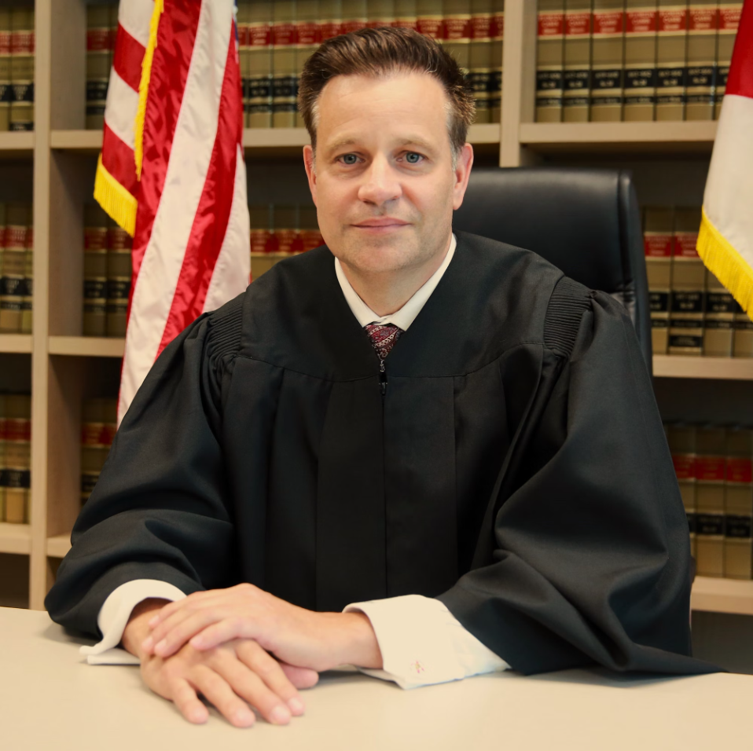

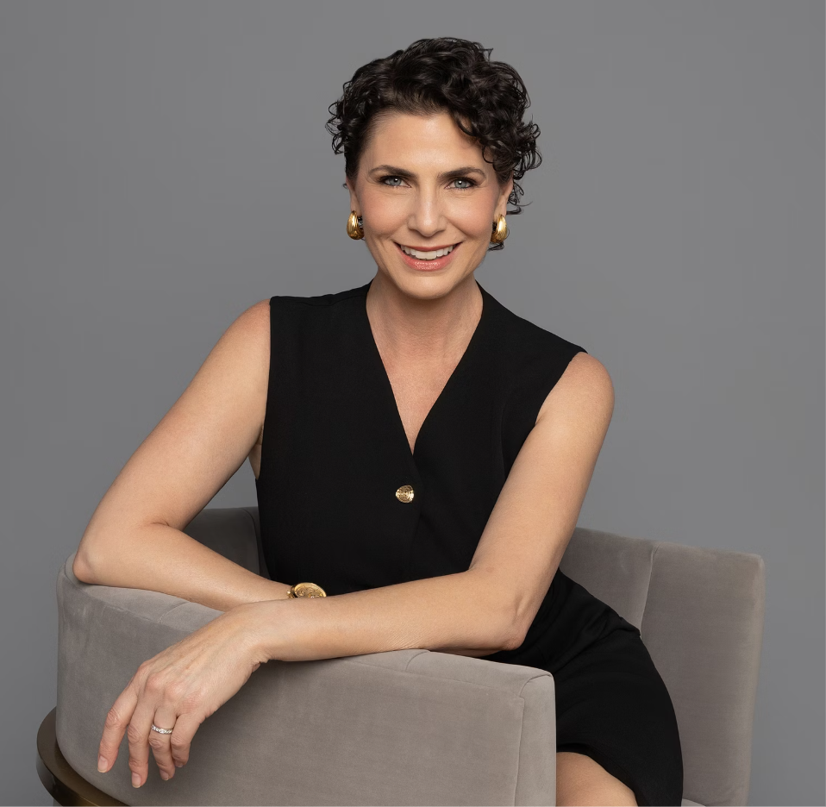
Welcome & Introductions
Judge Christopher Wigand
Fritznie Jarbath, Esq.
Angela Neave, Esq.
Judicial perspective
Practitioner's perspective
Litigation perspective

Slide 3
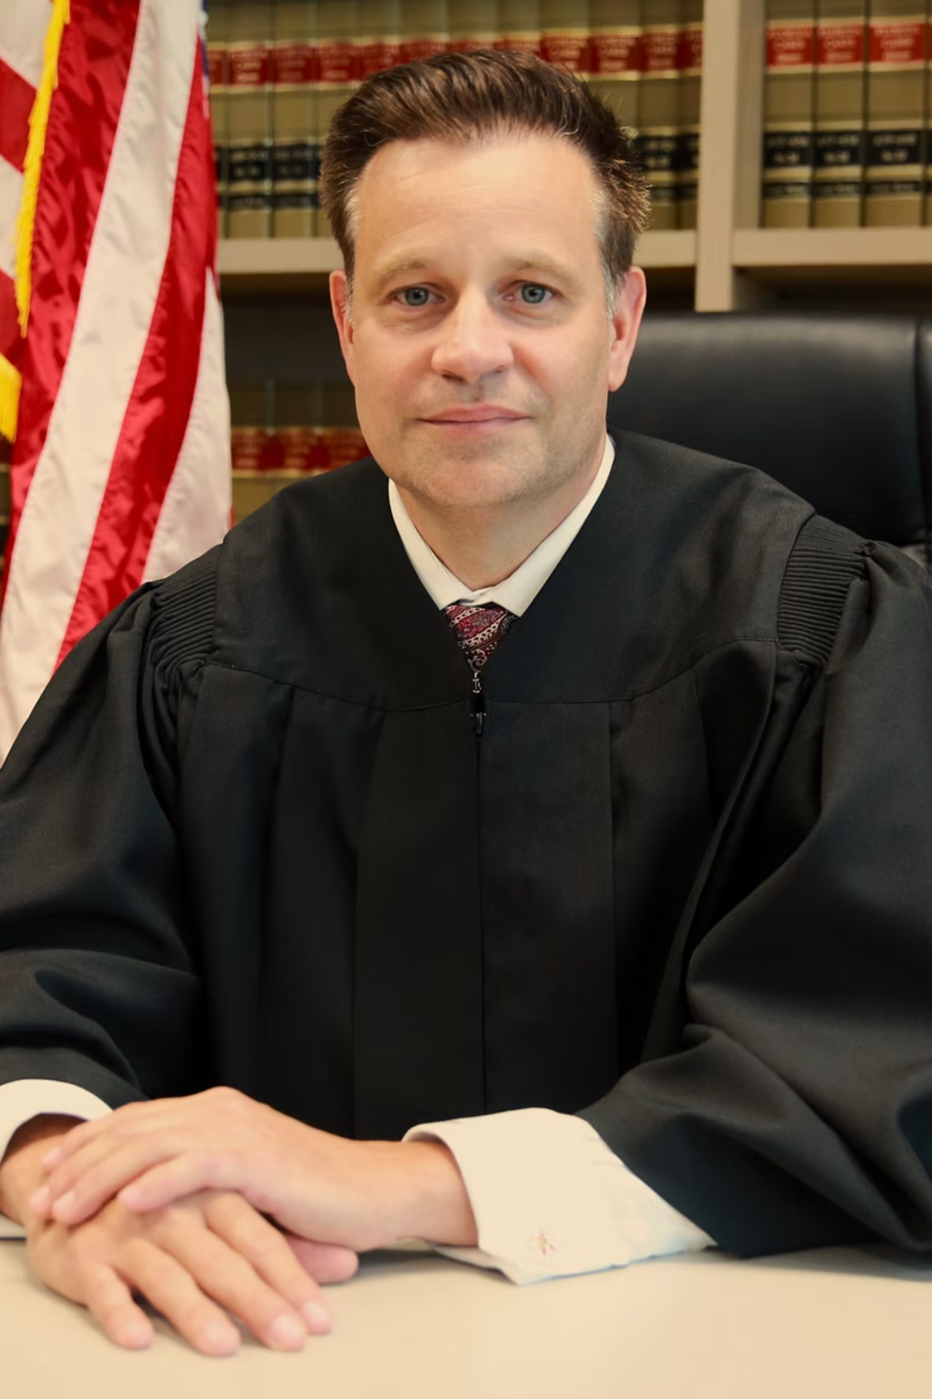
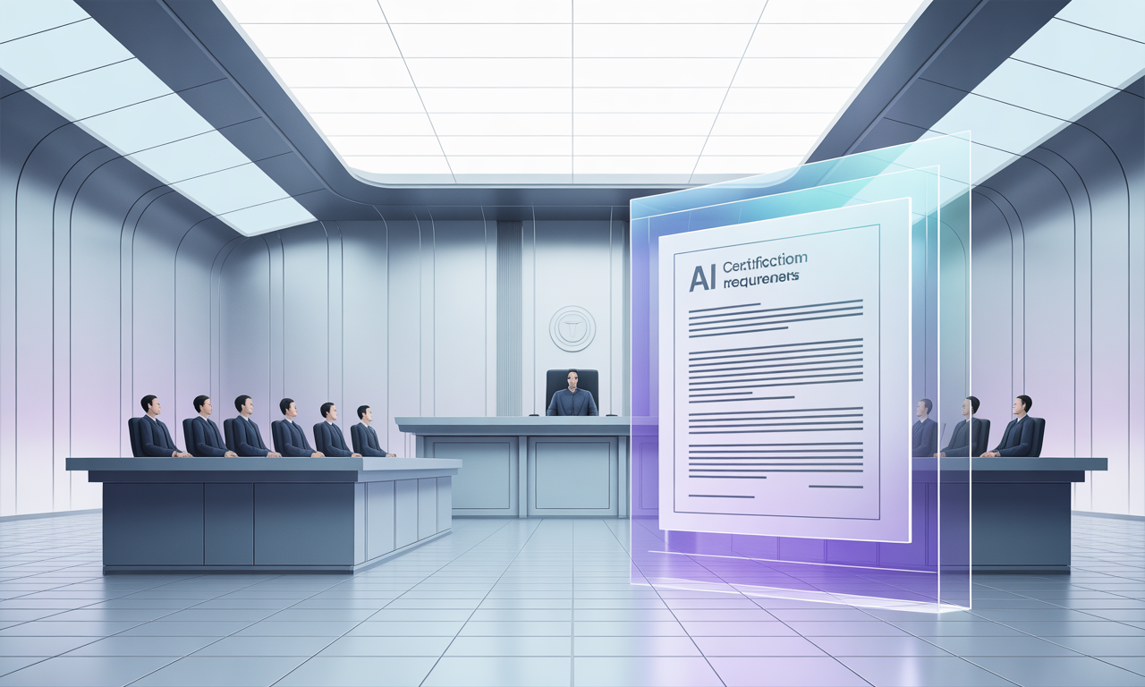
Judicial Perspective
Hon. Judge Wigand

Slide 4




Ethical Concerns in Domestic Violence Cases
AI Generated evidence fabricated alleging domestic violence
How to combat against providing fraudulent images or videos
Due Diligence
Verify original sources
Thoroughly investigate all submitted evidence
Ask for the client to bring the source material directly from their phone or server
Check the MetaData (date, time, location image was generated)
Implement multiple
verification methods
Not fool proof, but better than nothing.
Examine technical details
Here are some examples of some generative AI

Slide 5
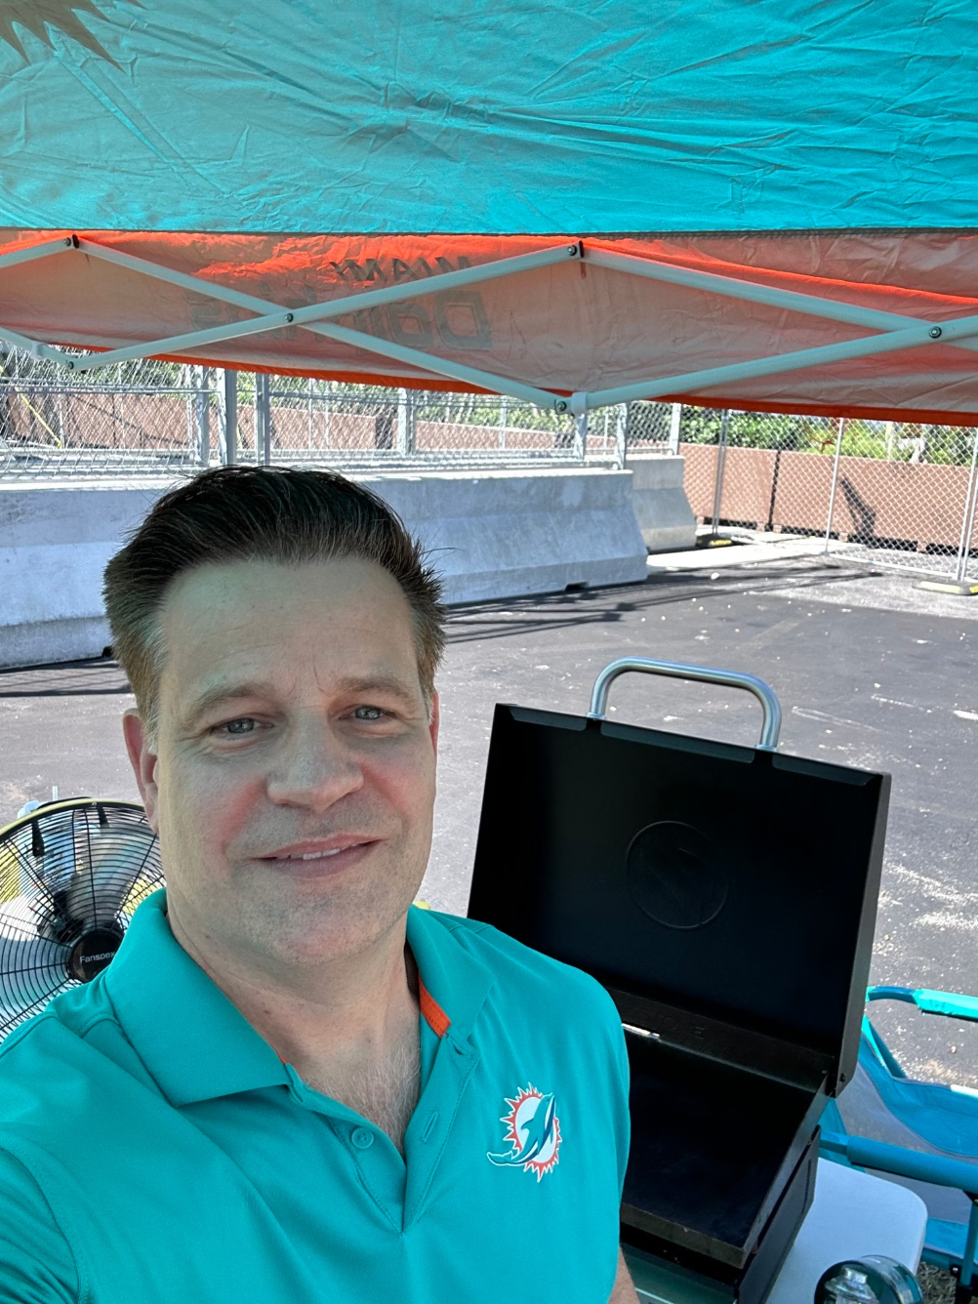
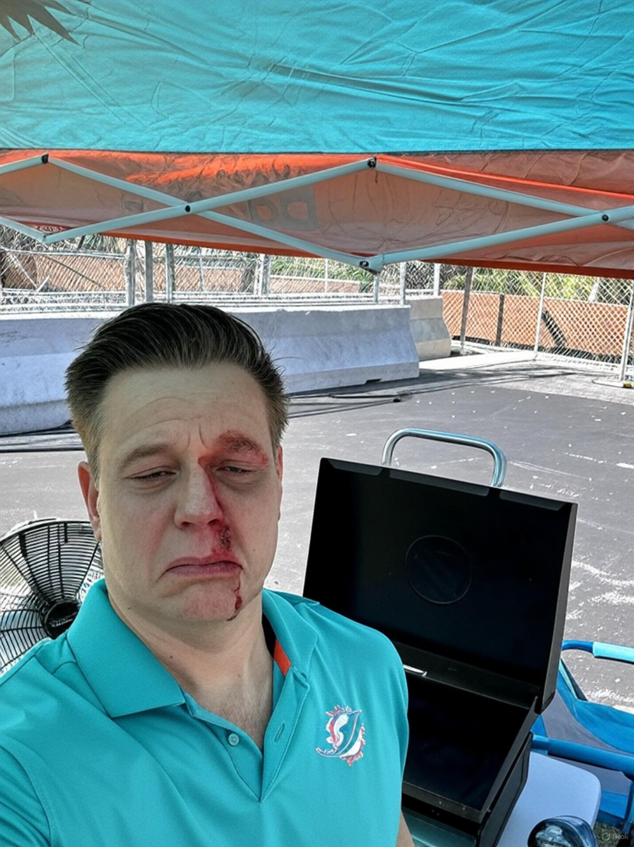
Fake AI Photos
I asked AI to take the original picture and make it look like he was beat up.
Asked it to give me a bloody nose and remove my smile and make me appear to be crying.
BEFORE
AFTER

Slide 6
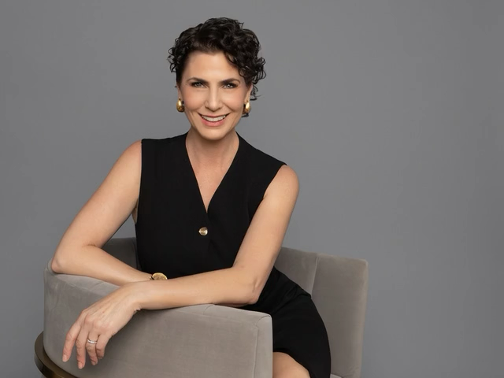
DEEP FAKE VIDEO

Slide 7





Ethical Concerns in general practice:
Florida Bar Ethics Advisory Opinion 24-1
Client Confidentiality
Accuracy &
Responsibility
Lawyers must protect client information when using generative AI, researching program policies on data retention, sharing, and self-learning to ensure privacy.
Ethical Billing
Lawyers are responsible for their work product and professional judgment, verifying AI use aligns with ethical obligations and ensures competent services.
Generative AI does not permit improper billing practices, such as double-billing, and lawyers must avoid such conduct.
Advertising Compliance
Technological
Competence
AI chatbots communicating with clients must comply with lawyer advertising restrictions and include a disclaimer that they are AI, not a lawyer or firm employee.
Lawyers should maintain technological competence and educate themselves on the risks and benefits of new technologies like generative AI.
https://www.floridabar.org/etopinions/opinion-24-1/

Slide 8


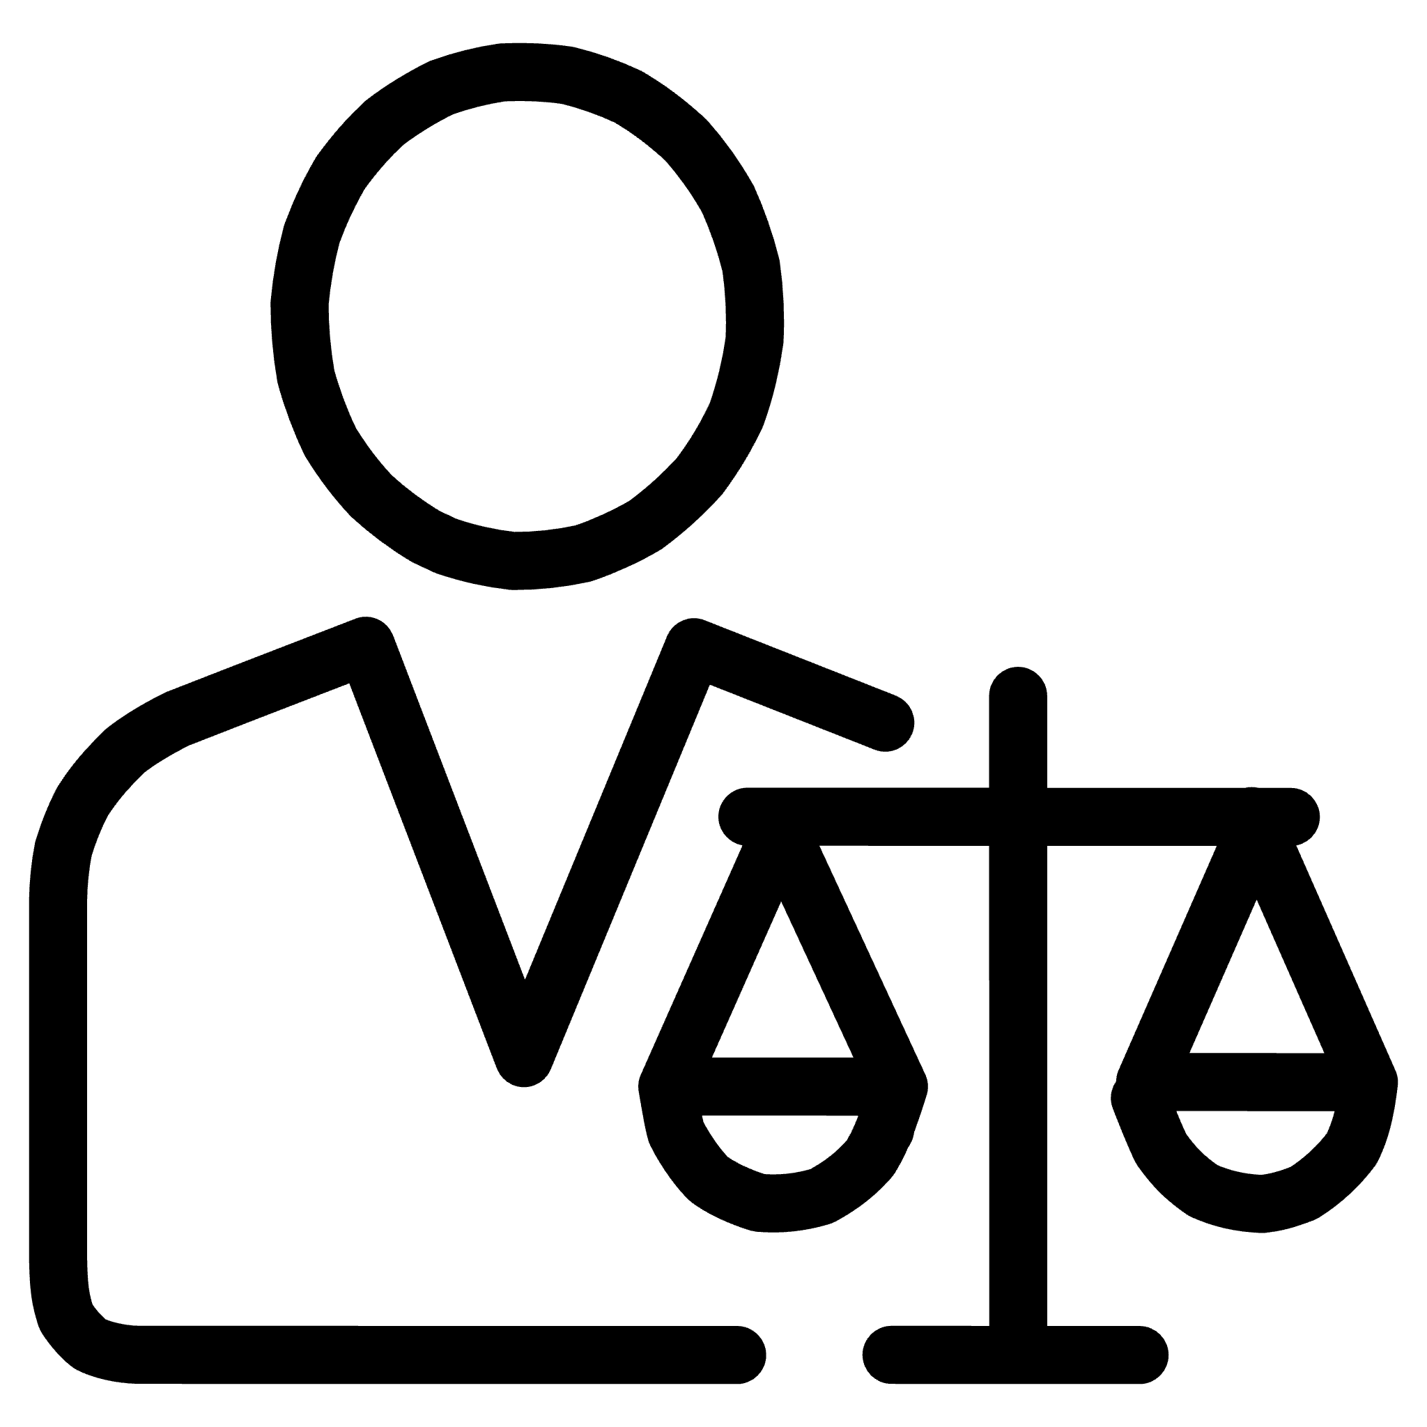


ABA Formal Opinion 512:
Competence in the Age of AI
Duty of Competent Representation
Acquiring GAI Competence
Model Rule 1.1 requires lawyers to provide competent representation, exercising necessary legal knowledge, skill, thoroughness, and preparation. This includes understanding the benefits and risks of technologies used in legal services.
Lawyers can achieve competence by self-study, collaborating with other competent lawyers, or consulting individuals with GAI expertise. They don't need to be GAI experts but must understand the specific GAI tool's capabilities and limitations.
Vigilance in GAI Evolution
Staying Current with GAL
Given the fast-paced evolution of GAI tools, technological competence demands continuous vigilance regarding their benefits and risks. This is an ongoing undertaking, not a static achievement.
Lawyers should consider various approaches to keep up, such as reading about legal-specific GAI tools, attending relevant continuing legal education (CLE) programs, and consulting those proficient in GAI technology.
https://www.americanbar.org/content/dam/aba/administrative/professional_responsibility/ethics-opinions/aba-formal-opinion-512.pdf

Slide 9


Expectations for Lawyers in the Courtroom
Client confidentiality, supervision, billing practices
Client Confidentiality
Competence and Oversight
Rule 4-1.6 and Model Rule 1.6
Rule 4-1.1 and Model Rule 1.1
Lawyers must protect confidential client information when using generative AI.
Attorneys are responsible for maintaining technological competence.
Informed consent is required before sharing client details with AI platforms.
AI outputs must be reviewed and verified by a human attorney.
Understand if the AI retains data or uses it to train future models.
Lawyers must supervise the use of AI and ensure compliance with all ethical rules.

Slide 10
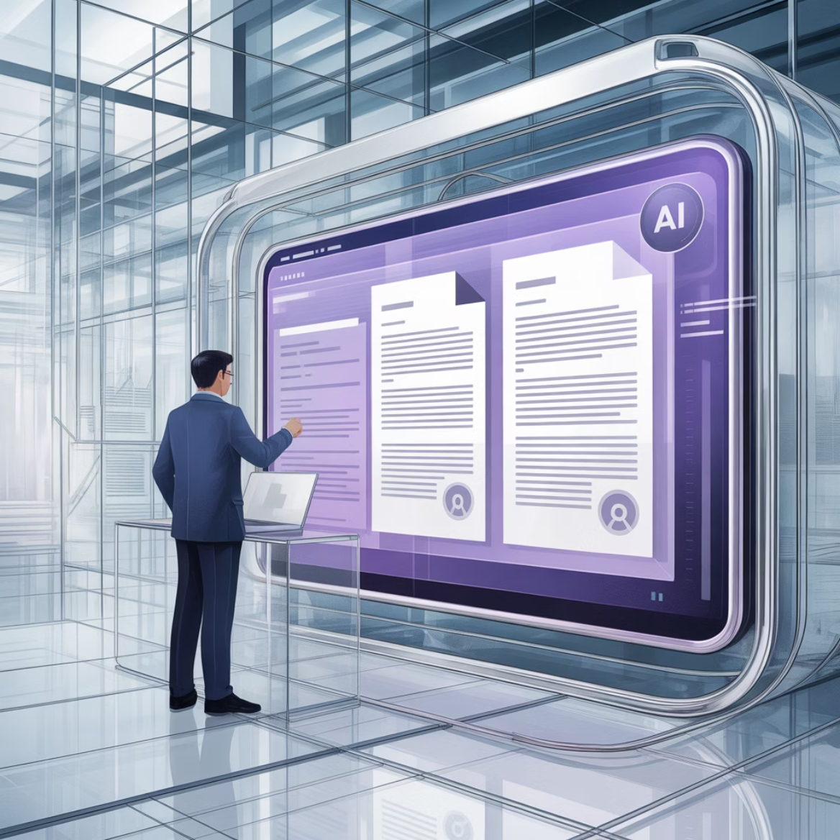
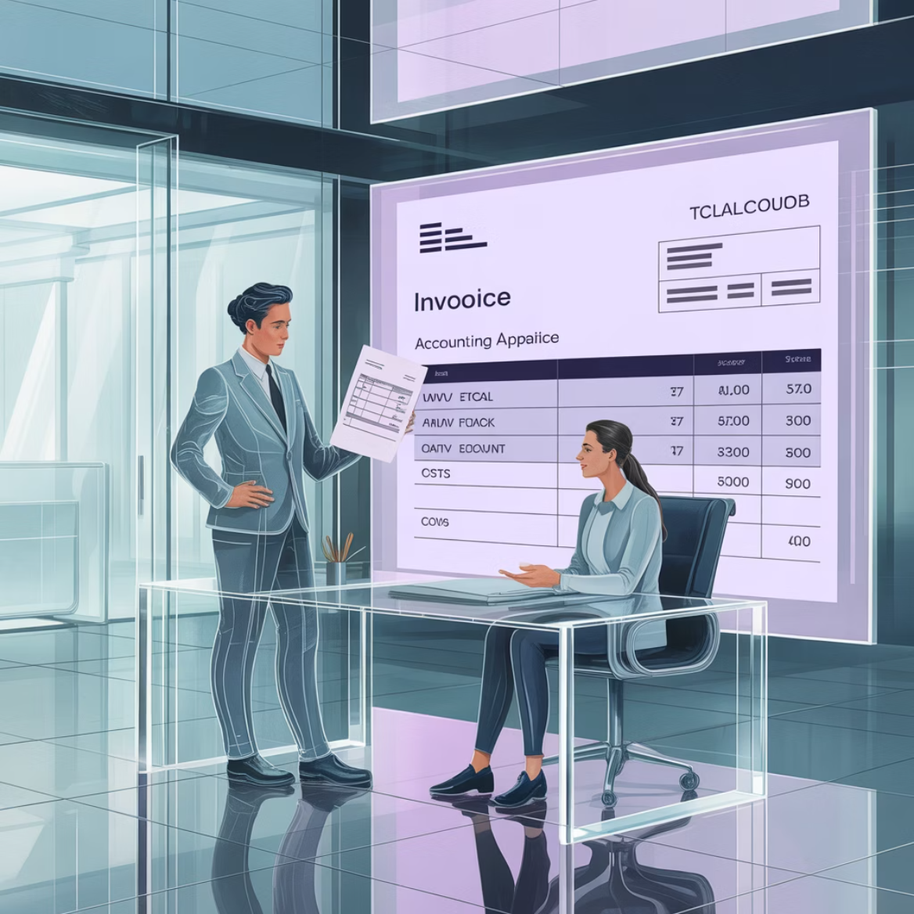
Expectations for Lawyers in the Courtroom
Supervision
Billing Practices
Rule 4-5.3 and Model Rules 5.1 and 5.3
Rule 4-1.5 and Model Rule 1.5
Treat AI tools like you would a nonlawyer staff member.
No double-billing for time saved using AI.
Implement policies for review, approval, and supervision of AI outputs.
Fees must remain reasonable and reflect actual time and value.
Ensure AI usage does not lead to the unauthorized practice of law.
Disclose any AI-related costs transparently in client agreements.

Slide 11
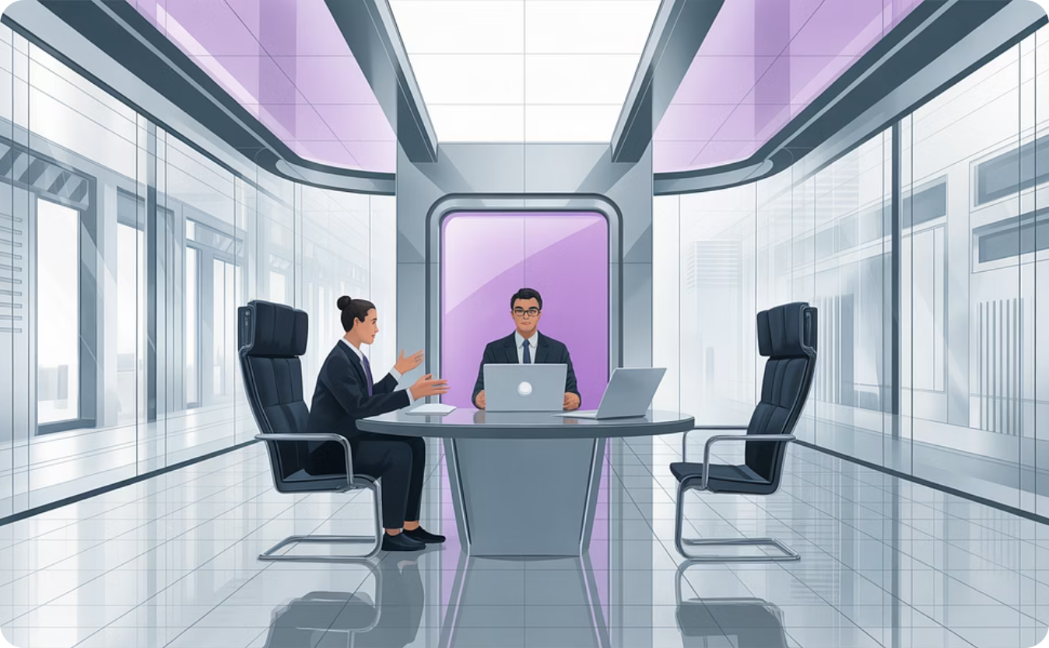
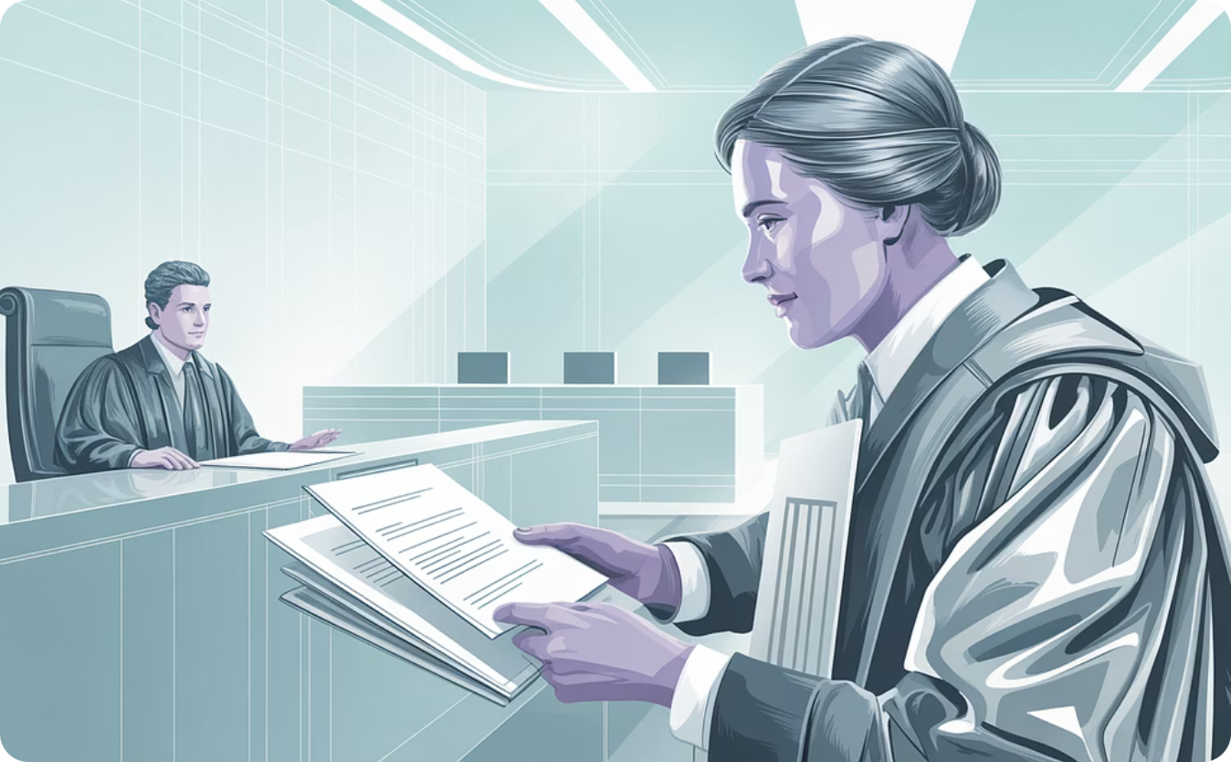
Expectations for Lawyers in the Courtroom
Advertising and Communication
Candor toward the tribunal and AI certifications
Subchapter 4-7 and Model Rule 1.6
Model Rule 3.3
AI-generated client communications must comply with legal advertising rules.
Any information submitted to the court must be verified for accuracy.
Clearly disclose when clients are interacting with an AI system.
Lawyers should not rely on AI outputs without review to avoid presenting false or misleading data.
Do not make misleading claims about the abilities of AI in your practice.
Be aware of certification requirements

Slide 12
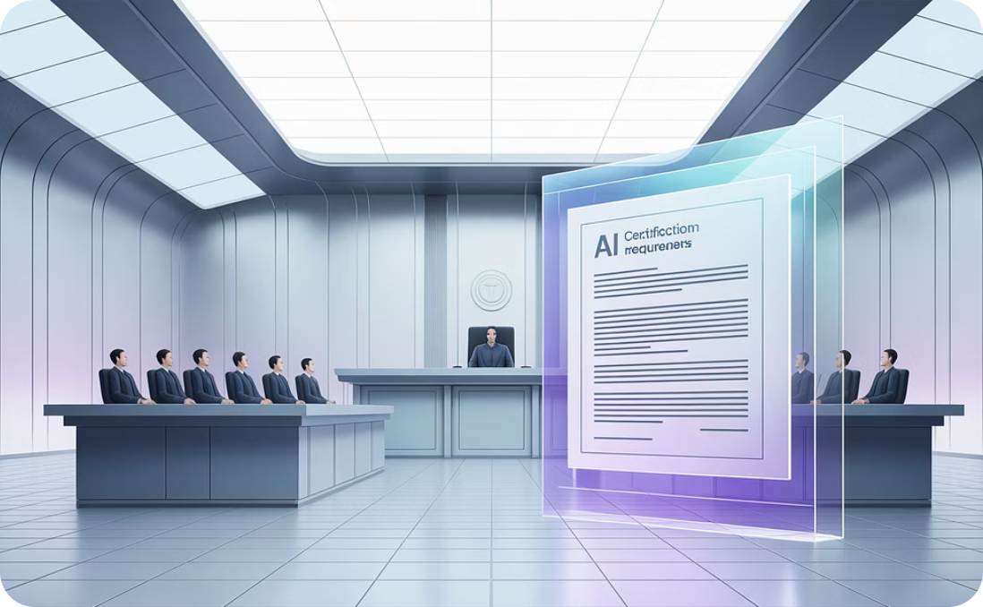
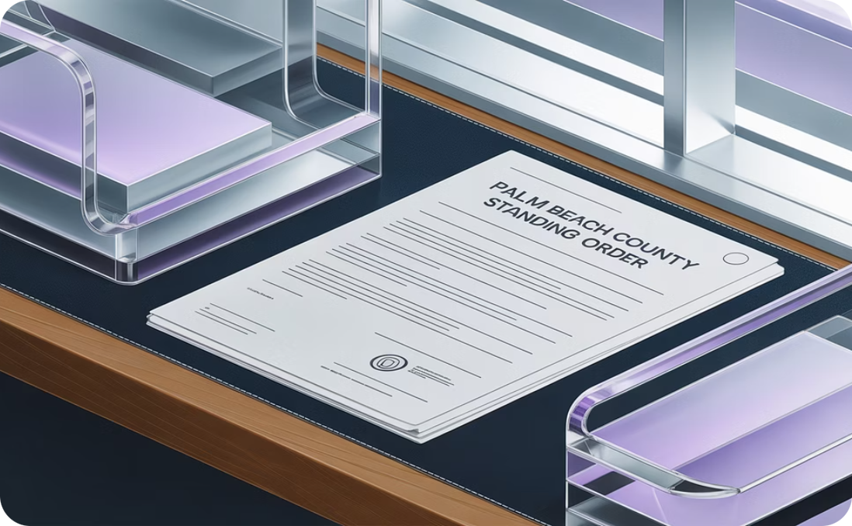
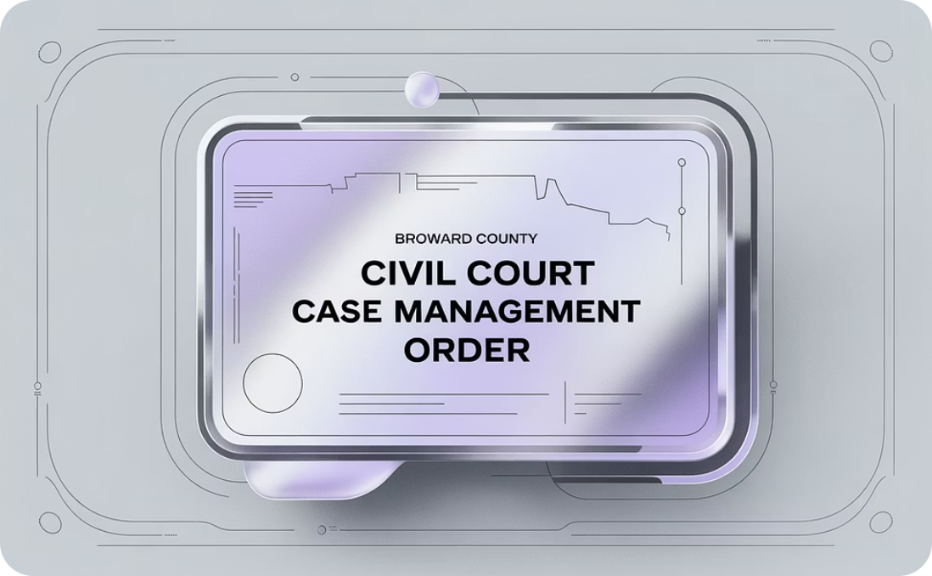
AI Certifications
As of March 2024,
Palm Beach County has its own Standing Order regarding AI.
Broward County Civil Court Case Management Order/Uniform Trial Order.
21 Federal trial judges
require AI certifications.

Slide 13
Broward Civil AI Certification
"An attorney may ethically utilize AI technologies but only to the extent that the lawyer can reasonably guarantee compliance with the lawyer's ethical obligations. Attorneys must comply with Florida law and the applicable Rules Regulating the Florida Bar. (See Florida Bar Ethics Opinion 24-1 (Jan. 19, 2024)).
If any attorney or pro se party submits to the court any filing or submission containing AI-generated content, that attorney or pro se party must disclose the use of artificial intelligence on the face of the document and also must include a certification that the attorney or pro se party has personally reviewed and verified the content's accuracy.
Failure to include this certification or comply with this verification requirement will be grounds for sanctions, as permitted by law."
https://www.17th.flcourts.org/wp-content/uploads/2025/04/2024-26-Civ-Amendment-2-With-Exhibits-A-M-_04-15-2025-2.pdf

Slide 14
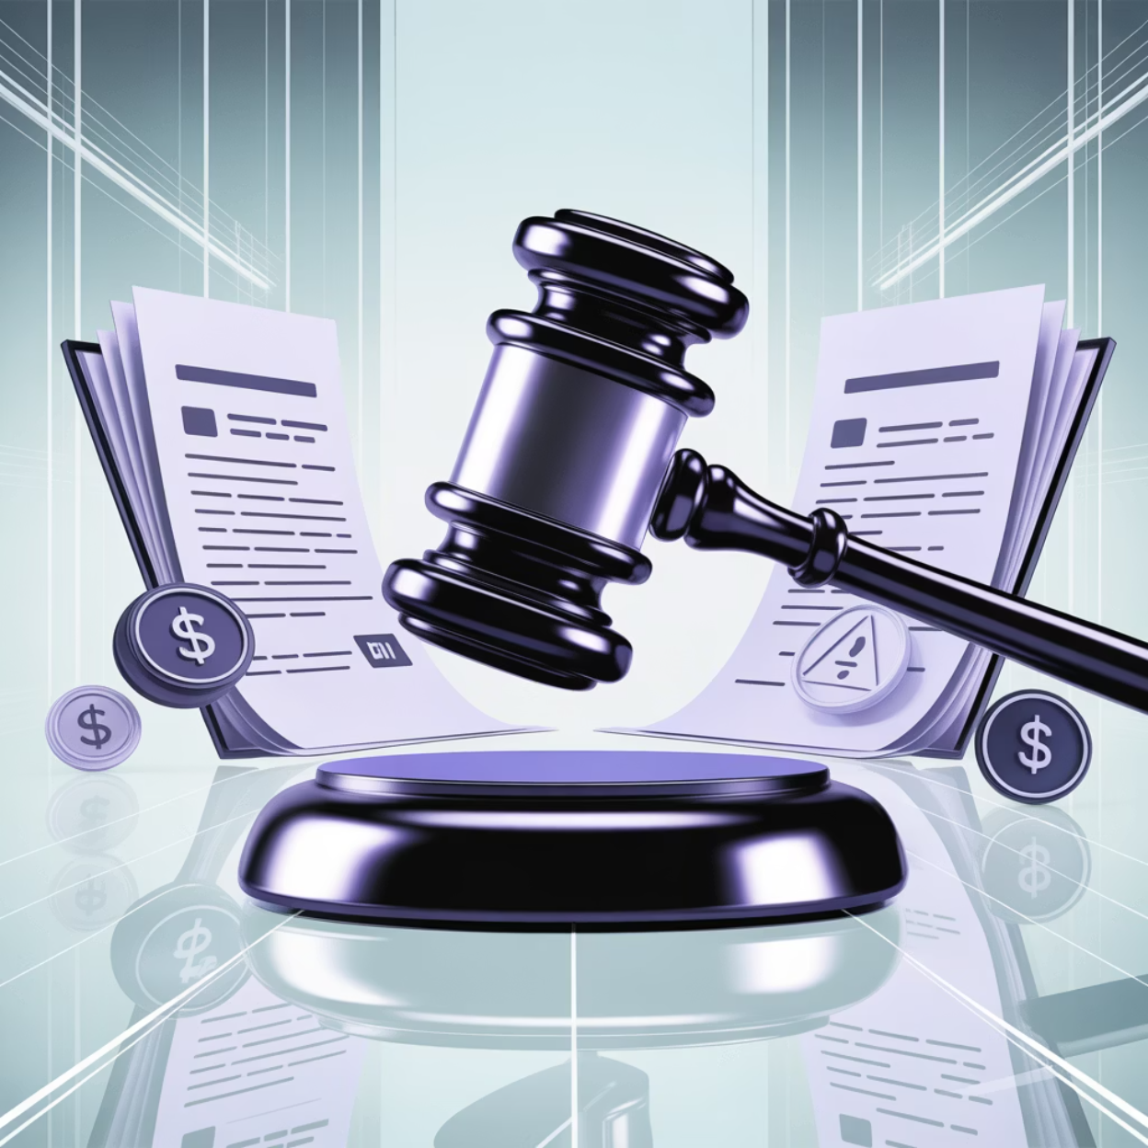
AI Hallucination Cases
Prevalence of AI Hallucinations
As of Oct 27, 2025 – 325 cases have been recorded according to the DamienCharlotin.com website, highlighting the growing concern regarding AI-generated content in legal practice.
Explore cases on DamienCharlotin.com
Consequences in Legal Practice
These cases underscore the critical need for attorneys to verify AI-generated content. The list includes the
Below are the Top 5 cases with the highest monetary sanctions, demonstrating severe repercussions for non-compliance.

Slide 15
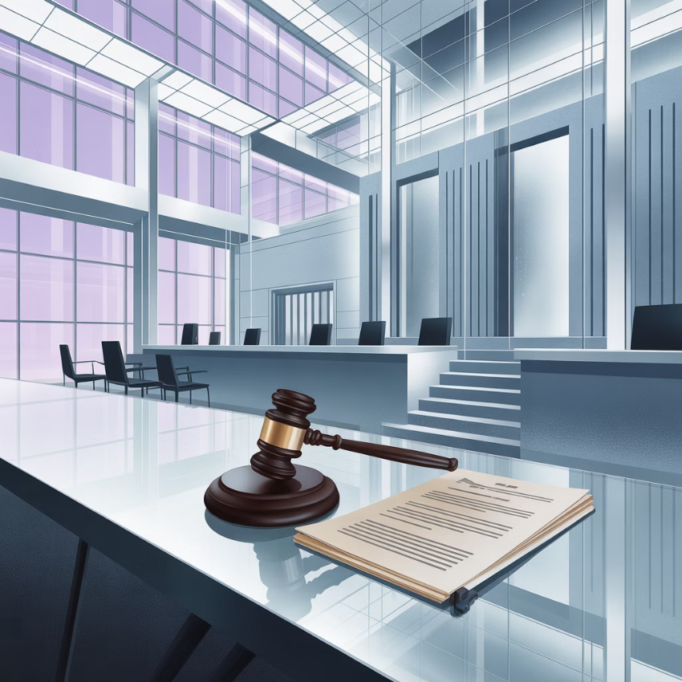
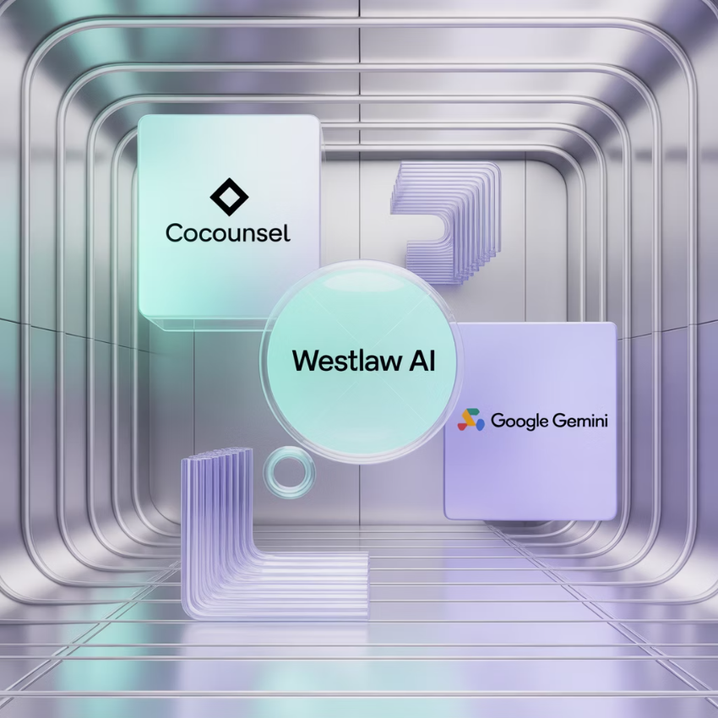

Case #1: Lacey v. State Farm General Insurance
$31,100 fine - California – May 6, 2025
Case Details
AI Tools Used
Consequences & Sanctions
This case highlights the critical need for attorneys to verify AI-generated content. A $31,100 fine was imposed in California on May 6, 2025.
Counsel used CoCounsel, Westlaw AI tools, and Google Gemini to generate a legal outline. This outline contained hallucinated citations and quotations.
The hallucinated content was incorporated into the filed brief by colleagues at both Ellis George and K&L Gates without verification.
After the Special Master flagged issues, a revised brief still included six AI-generated hallucinations, leading to significant sanctions.

Slide 16


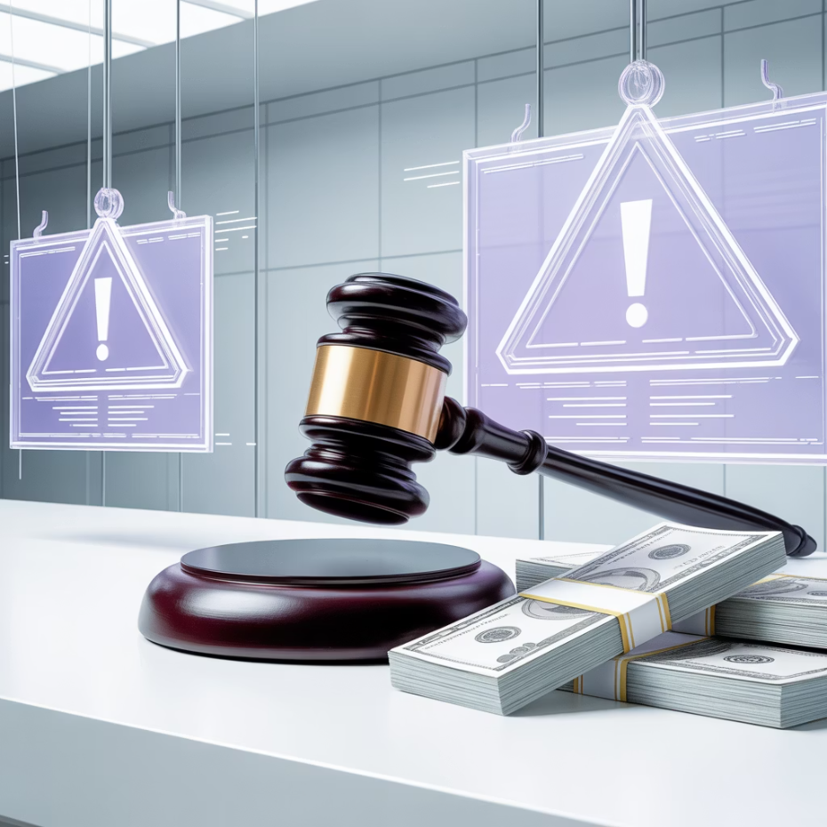
Case #2: Mattox v Product Innovation Research
$28,495 fine – Oklahoma – October 22, 2025
Case Overview
AI Misuse & Verification Failure
Sanctions & Accountability
This case involved 28 false or misleading citations across 11 pleadings (14 fabricated, 14 erroneous/misquoted) found by the Court. The penalties were significant, with a total fine of $28,495 imposed.
Attorney Mr. Howie admitted to using ChatGPT and failing to verify the citations it generated. This led to a substantial number of inaccurate legal references being submitted to the court.
The Court applied Rule 11(b) and its specific AI framework (verification, candor/correction, accountability). Sanctions and restitution were imposed, including fines of $3,000, $2,000, and $1,000 on individual attorneys, plus the opposing party's costs and fees.

Slide 17


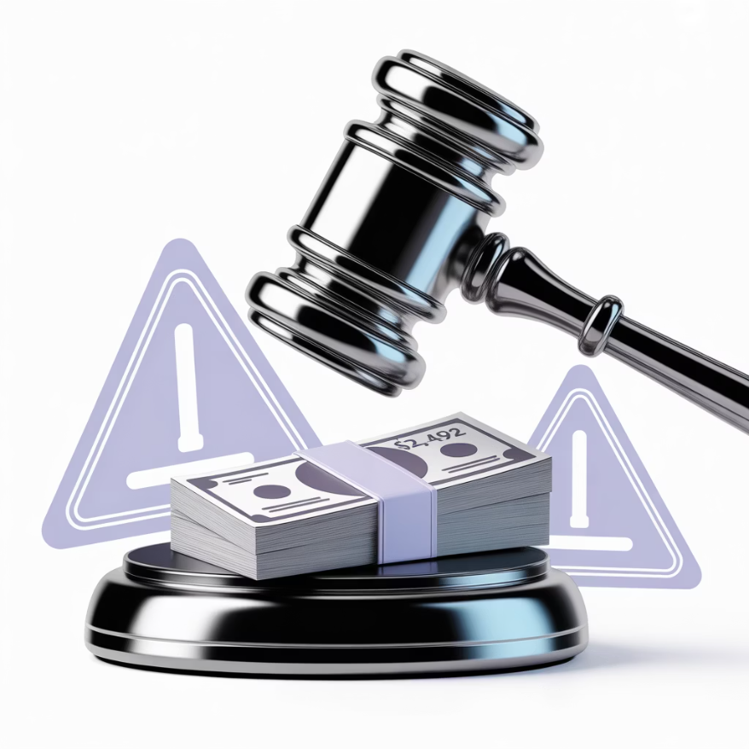
Case #3: Puerto Rico Soccer League v. Federacion Puertorriquena de Futbol
$24,492 – Puerto Rico - September 23, 2025
Case Overview
Problematic Citations & Defiant Tone
Monetary Sanctions Imposed
In this case, the court noted: "A simple Google search would have shown the problems in some of Plaintiff's citations. In other instances, a quick search of the opinion Plaintiff's cited to would have revealed problems." The case involved a fine of $24,492 imposed in Puerto Rico.
The court found "it problematic that Plaintiffs responded to a show cause order to address the problem of multiple inaccurate citations by providing a response containing more erroneous citations." They highlighted that the "Memorandum in Compliance strikes a defiant and deflective tone" and "contains more of the errors that plagued Plaintiff's previous four filings."
"Levying appropriate sanctions here promotes deterrence without being overly punitive, as contemplated by Rule 11(c)(4)." Monetary sanction was decided in a subsequent decision dated September 23, 2025.

Slide 18
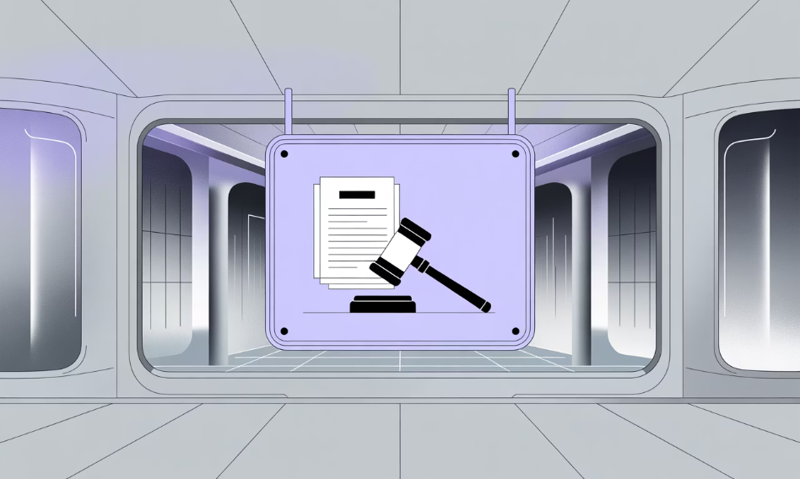
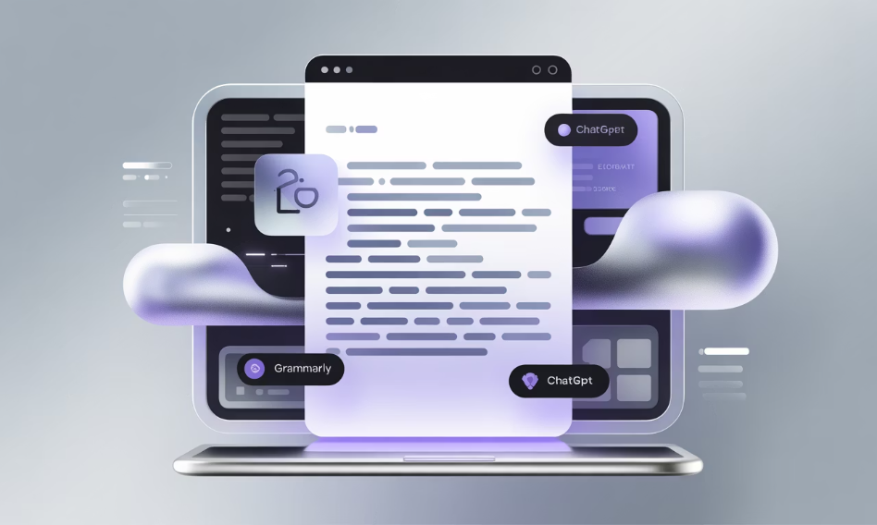
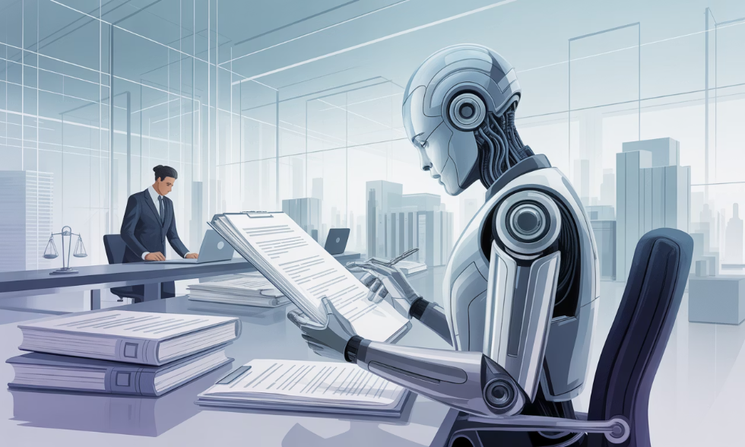
Case #4: Noland v. Land
$10,000 – California – September 12, 2025
Case Origin in California
Fabricated Quotations & Inaccurate Citations
The Dangers of AI Hallucinations
This case, resulting in a $10,000 sanction, originated in California. The court's ruling highlighted severe issues regarding fabricated content and inaccurate citations within legal documents.
Concluding its findings, the court stated, "'hallucination' is a particularly apt word to describe the darker consequences of AI." They warned, "AI hallucinates facts and law to an attorney, who takes them as real and repeats them to a court." The court emphasized the risk of these "hallucinations are circulated, believed, and become 'fact' and 'law' in some minds. We all must guard against those instances."
The court found that the appellant's opening brief contained "23 case quotations, 21 of which are fabrications." The reply brief had "many more fabricated quotations," and both were "peppered with inaccurate citations that do not support the propositions for which they are cited."

Slide 19


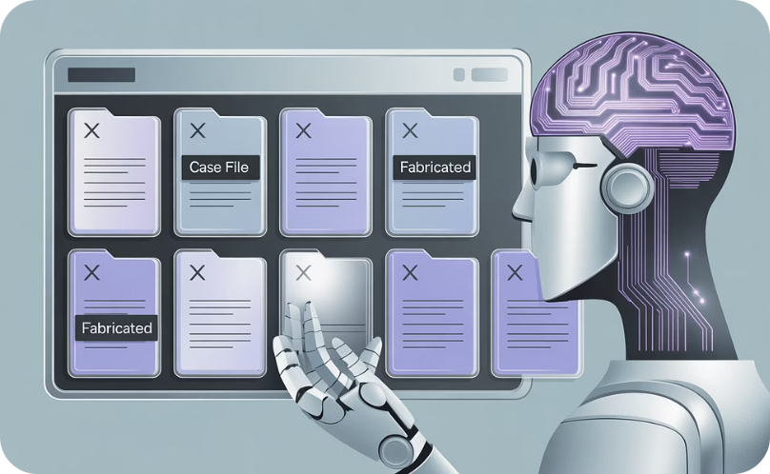
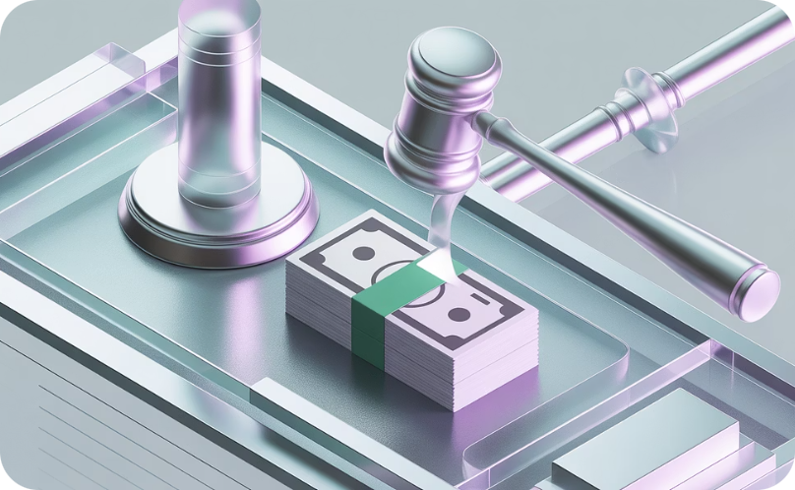
Case #5: In re Boy
$7,925.00 – Illinois – July 21, 2025
This case originated in Illinois, where counsel was sanctioned concerning an appeal regarding the termination of parental rights. The court found a violation of Illinois Supreme Court Rule 375.
The core of the case involved an appeal concerning the termination of parental rights, a sensitive family law matter that requires rigorous legal accuracy.
Counsel was sanctioned for citing eight nonexistent cases in briefs filed on behalf of his client. These fictitious citations were generated by AI without proper verification, leading to misleading legal submissions.
As a result, counsel was ordered to disgorge $6,925.62 received for his work and pay an additional $1,000 in monetary sanctions, totaling $7,925.00. A copy of the opinion was also sent to the Illinois Attorney Registration and Disciplinary Commission.

Slide 20


Practitioner's Perspective
Fritznie Jarbath, Esq.
AI in the every day practice of Law

Slide 21






Benefits of AI-Powered Note-Taking for Phone Calls & Virtual Meetings
What It Is: AI tools like Fireflies.ai, Fathom, Otter.ai, and others can transcribe and summarize calls (Zoom, Google Meet, RingCentral phone, etc.) in real time, organizing action items and saving notes.
Time-Saving Efficiency
Accurate Recordkeeping
Frees up attorneys and staff from manual note-taking. Time saved can be passed on as cost savings to clients.
Transcripts are reasonably accurate and searchable—helpful for revisiting specific topics or verifying instructions.
Enhanced Accountability
Integrated Workflow
Creates clarity around who said what and helps define clear follow-up actions.
Notes can be exported to your case management system or emailed to the client or team.
Versatility
Improved Collaboration
Can be used with clients, potential clients, opposing counsel, interpreters, and vendors.
Teams can access shared transcripts and action items, reducing internal miscommunication.

Slide 22
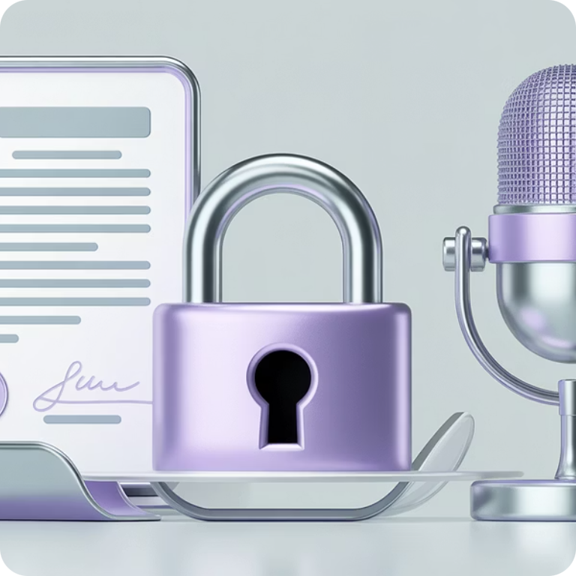


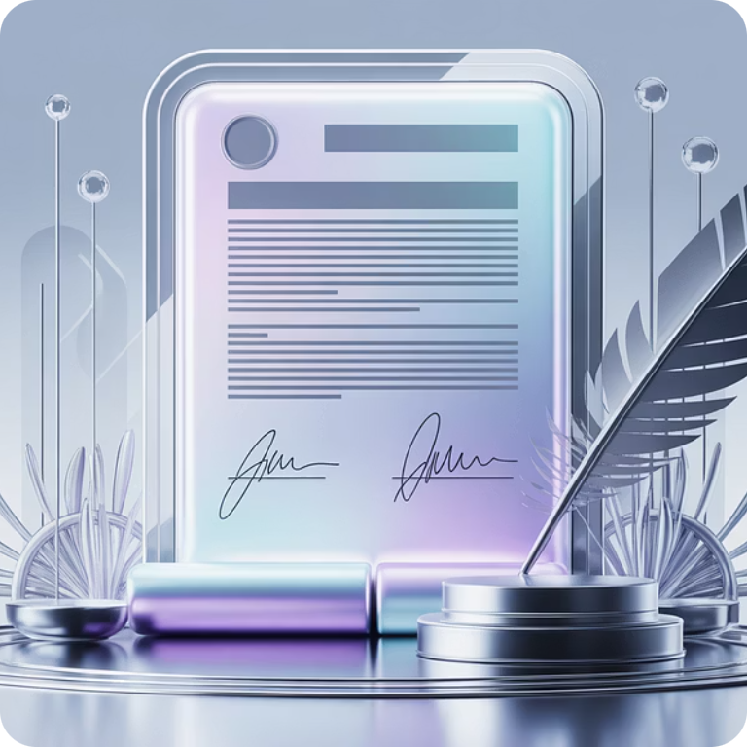
AI Note-Taking: Risks &Considerations
Consent Issues
Data Privacy & Breach Risks
Professional Boundaries
Ethical Use
Did you obtain the speaker's consent? Consent laws vary by state (one-party vs. two-party).
Did you notify the other party that AI is listening? Transparency builds trust—and helps avoid ethical pitfalls.
Documented consent (written when feasible) should be standard, especially in sensitive matters (immigration, family law).
Have you vetted the provider's privacy policy? Ensure end-to-end encryption and secure storage before uploading sensitive data.

Slide 23
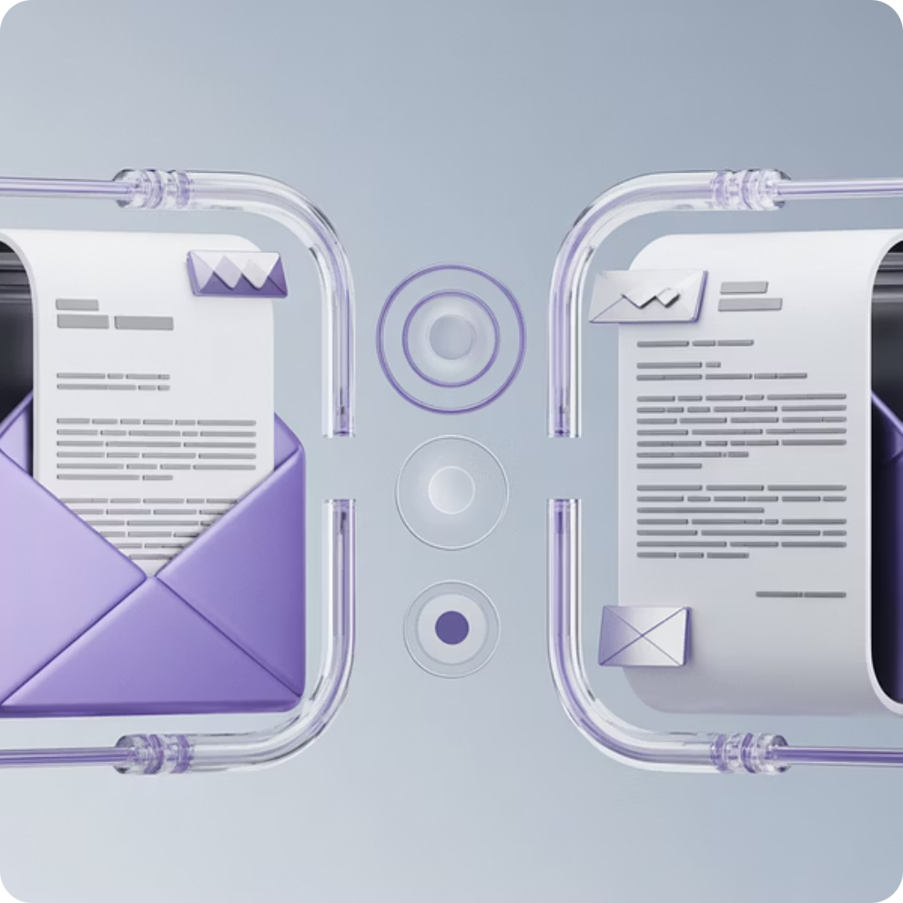
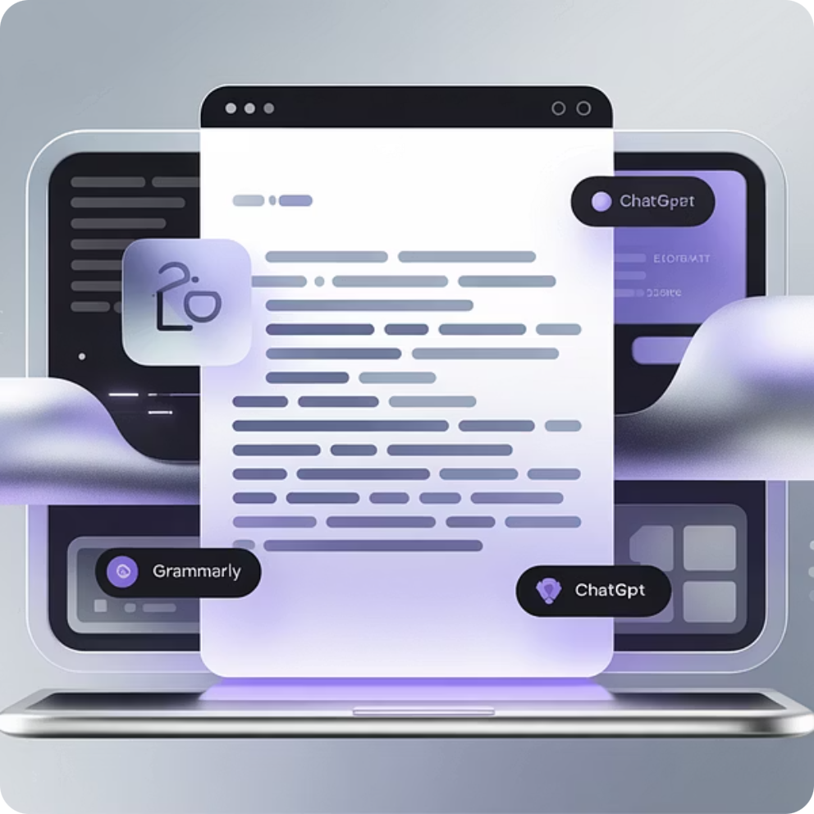
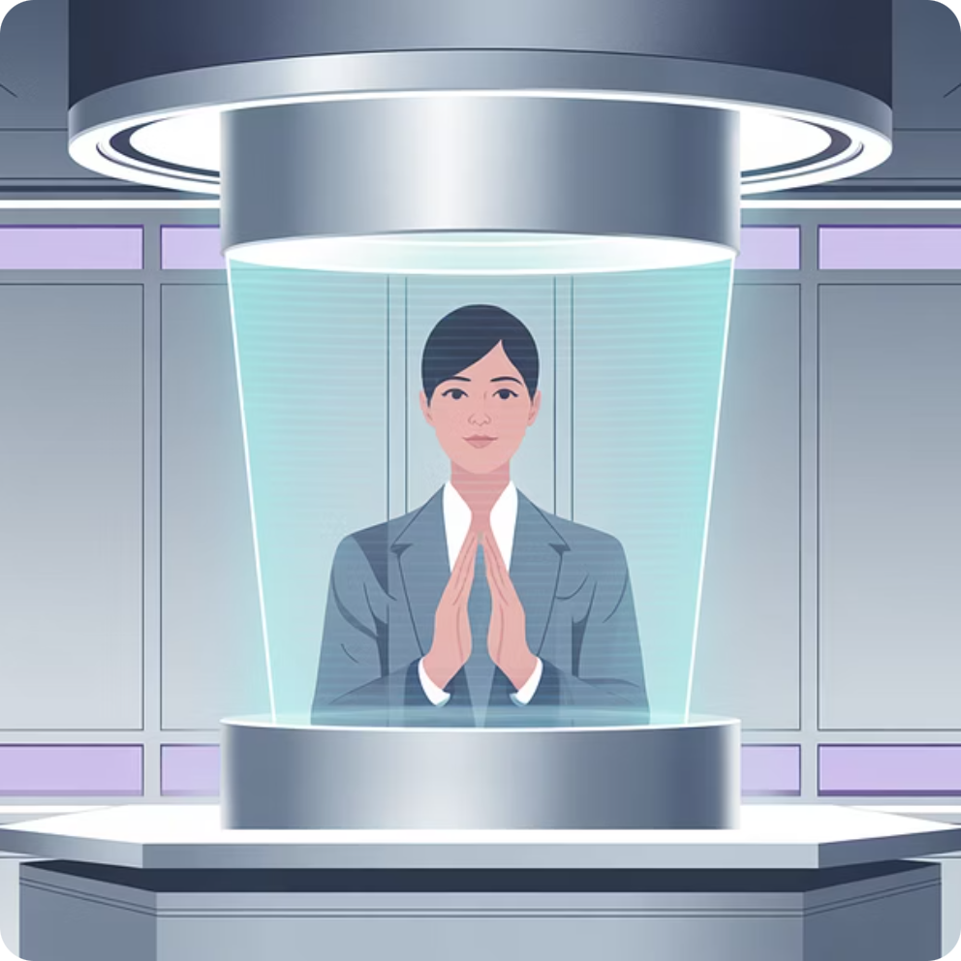
Email Communications with Opposing Counsel
Maintain Professional Tone
Leverage AI for Refinement
Critical in High-Conflict Cases
Ensure all correspondence is objective, respectful, and free from emotion-laden language.
Use tools like Grammarly, ChatGPT, or Crystal to analyze and fine-tune the tone of your emails.
A precise and neutral tone is essential to prevent escalation and maintain focus on legal matters.

Slide 24




Templates for Common Scenarios
Creating and using templated communications can drastically reduce email fatigue, minimize human error, and ensure consistency across your client interactions.
Scheduling & Logistics
Document Requests
Quick, polite replies for hearing scheduling, mediation dates, and document submission deadlines.
Standardized emails to request discovery, financial affidavits, disclosures, etc.
Settlement Proposals
Structured, neutral-toned templates for proposing or responding to resolutions.
Client Education
Pre-drafted answers to frequently asked questions

Slide 25







Client Education Templates
"What is a GAL (Guardian ad Litem)?"
"What happens during a Deposition?"
"How should I dress for court?"
"Zoom Hearing: Do's and Don'ts"
Why This Matters
As legal professionals, we go through these scenarios dozens—eventually hundreds—of times. But for the client, it's often their first and only experience with the legal system. What's routine to us can feel confusing, overwhelming, or even terrifying to them.
Client's First Experience
Professional Empathy & Guidance
Mitigate Risk & Enhance Experience
Templated resources help us maintain empathy and compassion across all communications, and avoid overlooking important but obvious instructions like courtroom attire or behavior.
Over time, it's easy to lose sight of that anxiety and the emotional weight our clients carry.
They help to minimize risk from a forgotten comment or rushed email, and enhance client experience through proactive, clear, and thoughtful guidance.

Slide 26

From Superhuman to Super-Sidekick
You're not expected to remember everything, every time.
That's where automation and AI-enhanced templates come in.
Think of them as your "super-sidekick"—ready to deliver consistent, professional, and compassionate communication so you don't have to reinvent the wheel every day.
With just a few clicks, your system can remind clients not to wear flip-flops to court, or explain what a deposition is—all while you focus on legal strategy, not logistics.

Slide 27

Exploring AI Resources in
Legal Practice
Traditional Legal AI Tools
Westlaw AI, Lexis+ AI
Advanced research, brief analysis, and citation tools baked into trusted platforms.
Other LegalTech Platforms
Tools like Casetext (CoCounsel), Paxton AI, and Harvey AI offer AI-enhanced drafting, legal reasoning, and research for attorneys.
AI tools come in different tiers—some are integrated into traditional legal research platforms, while others are new-generation tools designed for speed, creativity, or operational support.
Next-Gen AI Assistants
ChatGPT (OpenAI) - Great for drafting content, brainstorming arguments, simplifying legalese, or creating checklists—best used in non-confidential scenarios or with a business subscription.
Claude AI (Anthropic) - Known for longer context windows and a more conversational tone—useful for policy writing, summarizing long
documents, or generating Q&As.
Microsoft CoPilot - Integrated into Word, Outlook, and other Office products for real-time drafting, summarizing, and editing.
Google Gemini (formerly Bard) - Useful for document generation, process automation, and quick summaries—especially helpful if you're already in the Google
Workspace ecosystem.
Always Review Privacy Policies and Terms of Use
Not all platforms are created equal. Understand where your data is stored, who can access it, and whether client information is being used to train future models.

Slide 28
Recommended AI Protocols for Law Firms
As AI becomes more integrated into legal workflows, it's critical to have clear internal protocols that balance innovation with ethics and compliance.
When (and Whether) to Disclose AI Use
Client-Facing Work:
Internal Use Only:
Ethical Guidelines Vary by State:
If AI tools help create drafts or generate summaries for client matters, consider disclosing this in your engagement agreement or fee contract.
When AI is used strictly for back-office tasks (scheduling, transcription, brainstorming), disclosure may not be necessary, but firm-wide awareness is still important.
Stay updated on Bar guidance—some jurisdictions are starting to mandate disclosure of AI use in certain contexts.

Slide 29
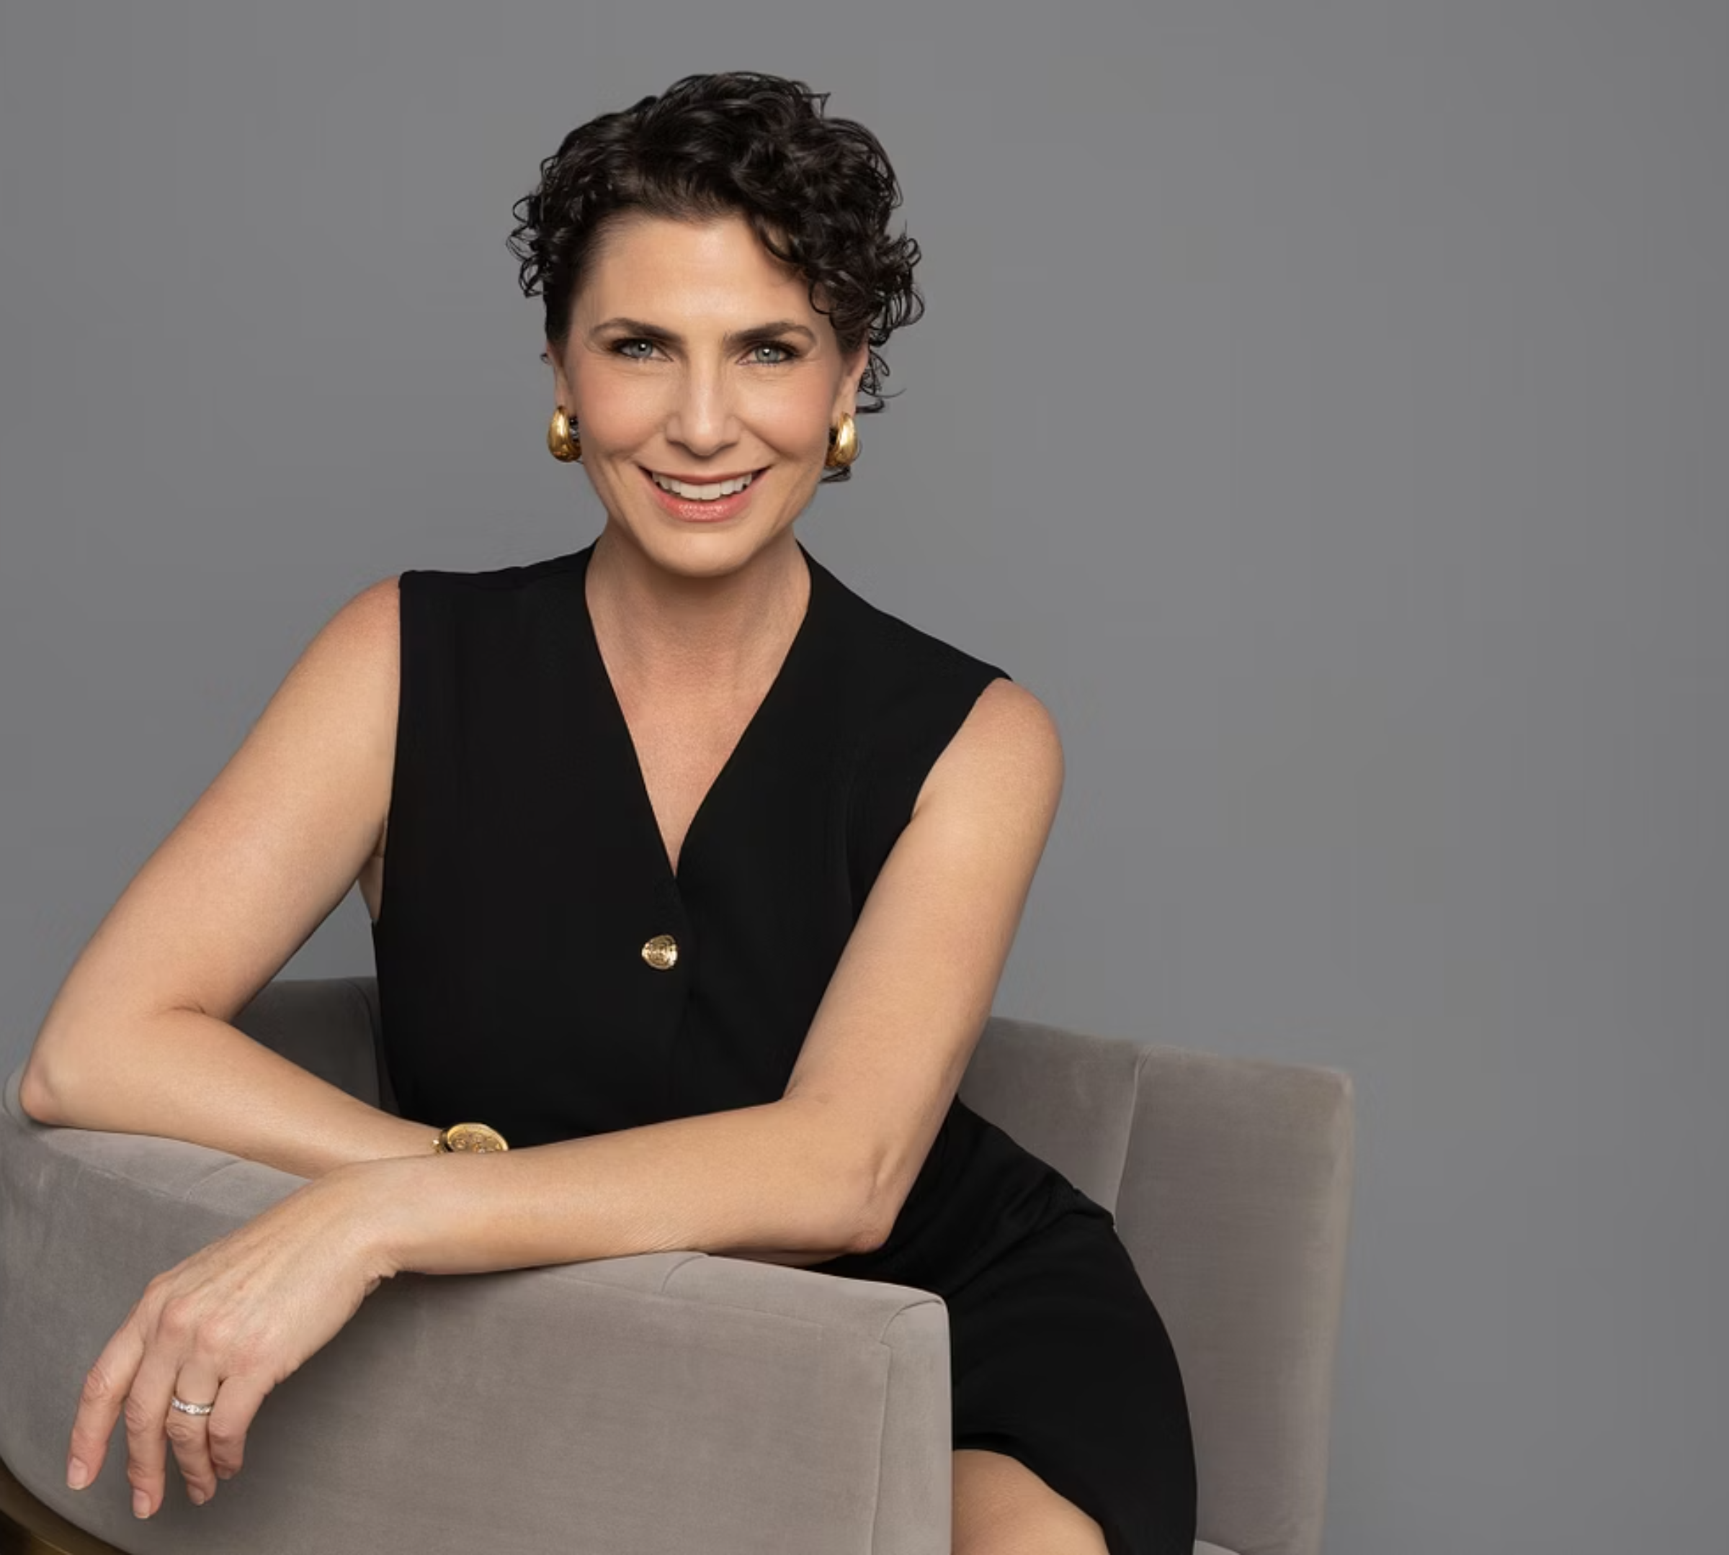
Angela Neave, Esq.
Litigator’s Perspective – AI in Court

Slide 30





Real LIFE example of us using AI for things like:
Opening Statements
Closing Arguments
Structuring your Presentation within a specific allotted time.
Demonstrative Aide:
Includes visual aids for complex topics.
Timesharing Matters
Financial Matters:
Parenting Plan Comparison Chart
Analysis of financial data and reports.
Other Helpful Demonstrate Ideas

Slide 31
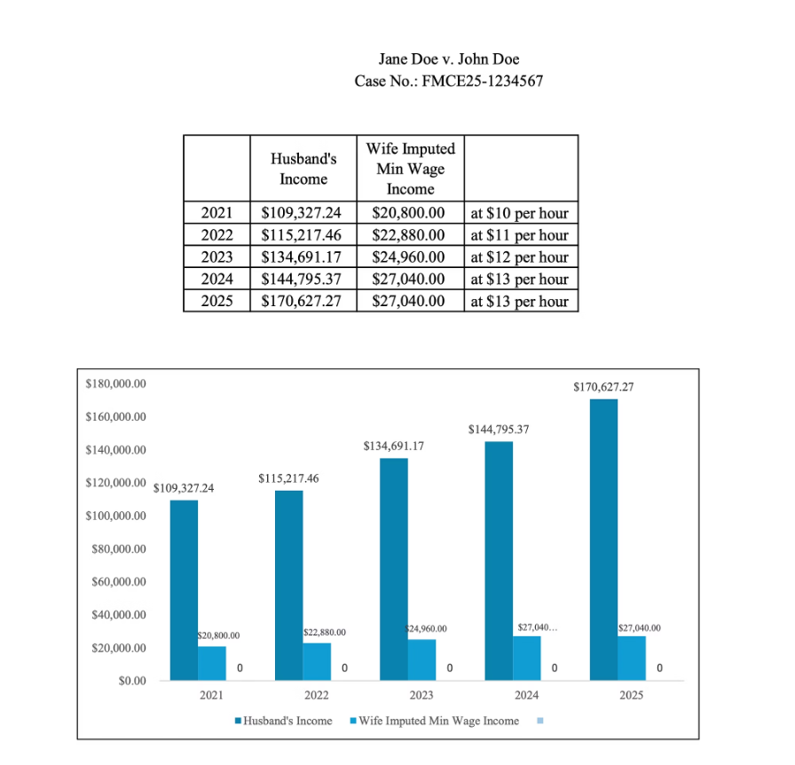
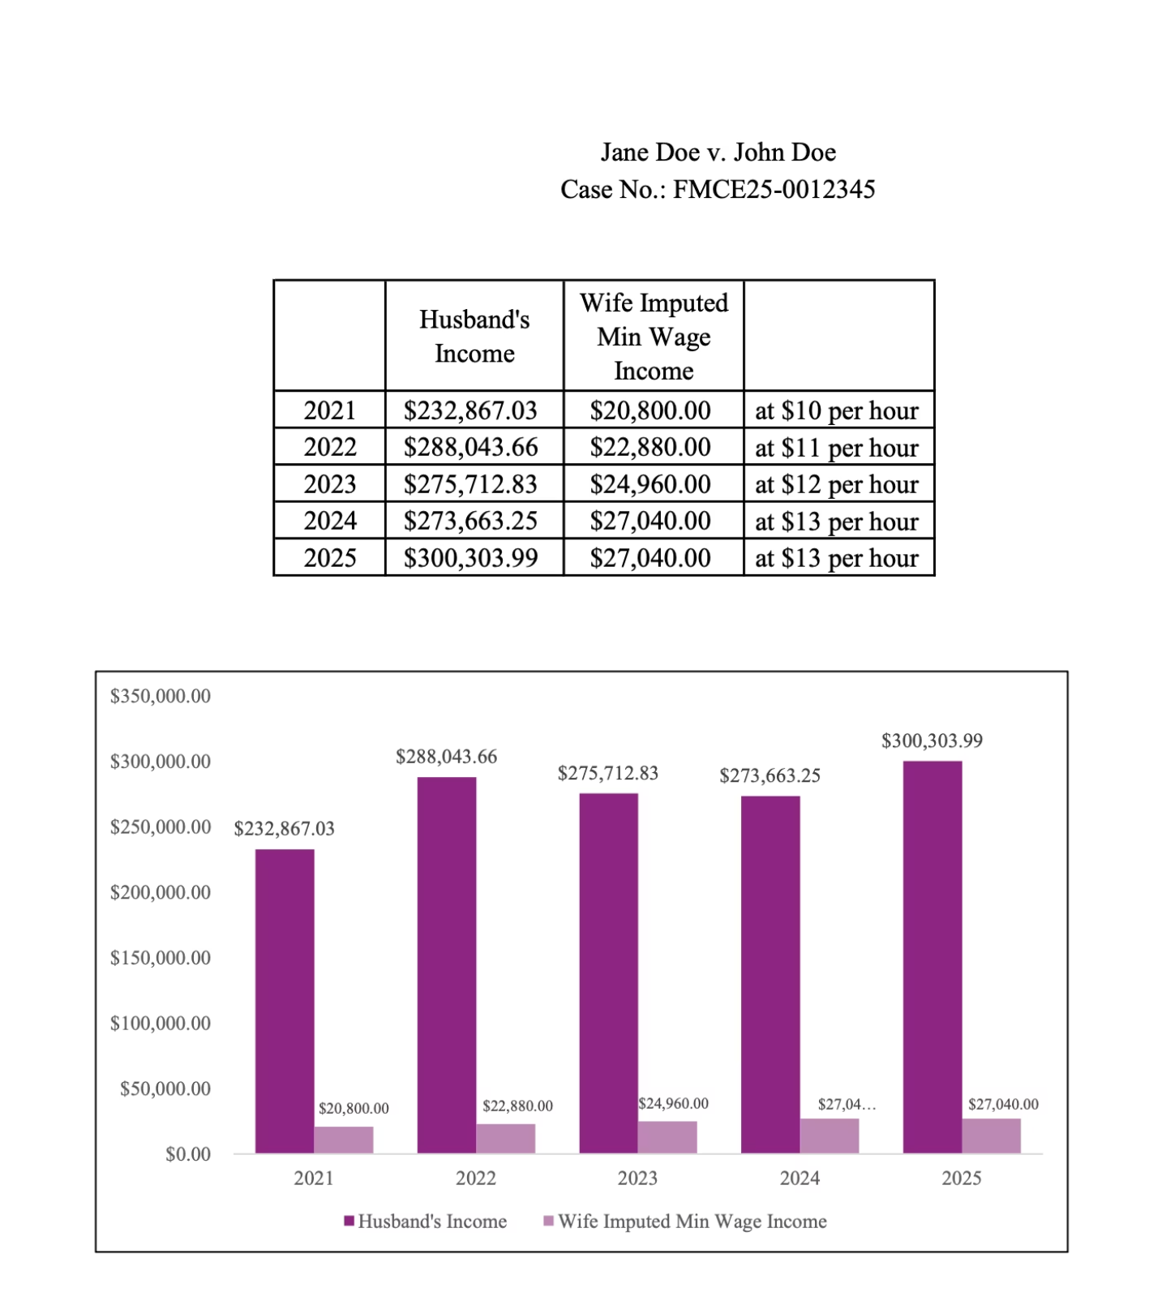
SAMPLE AI GENERATED DEMONSTRATIVE AIDES

Slide 32
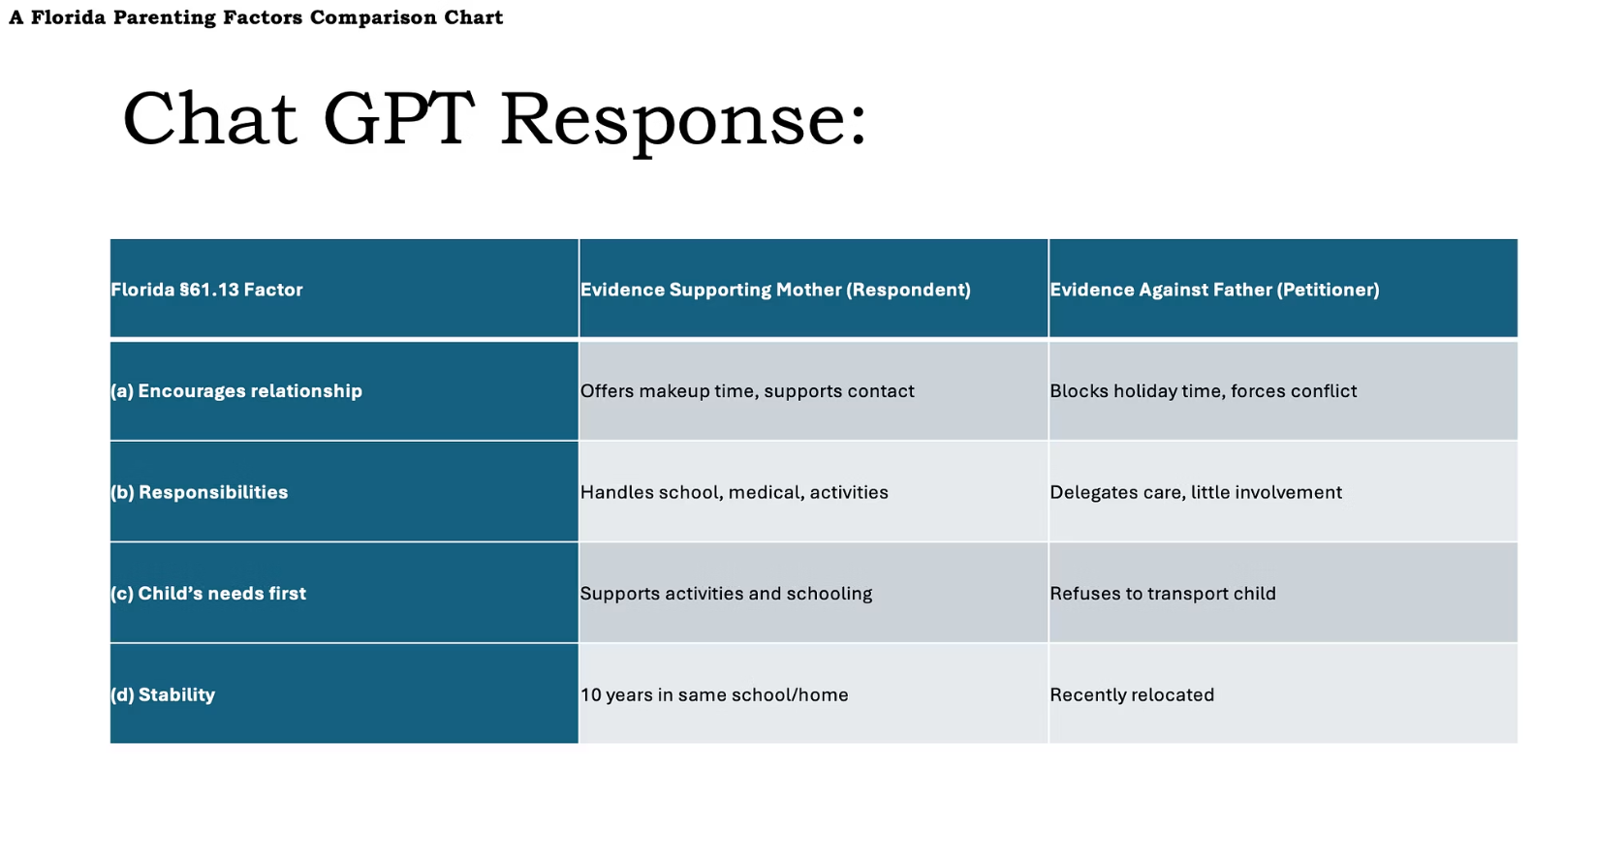
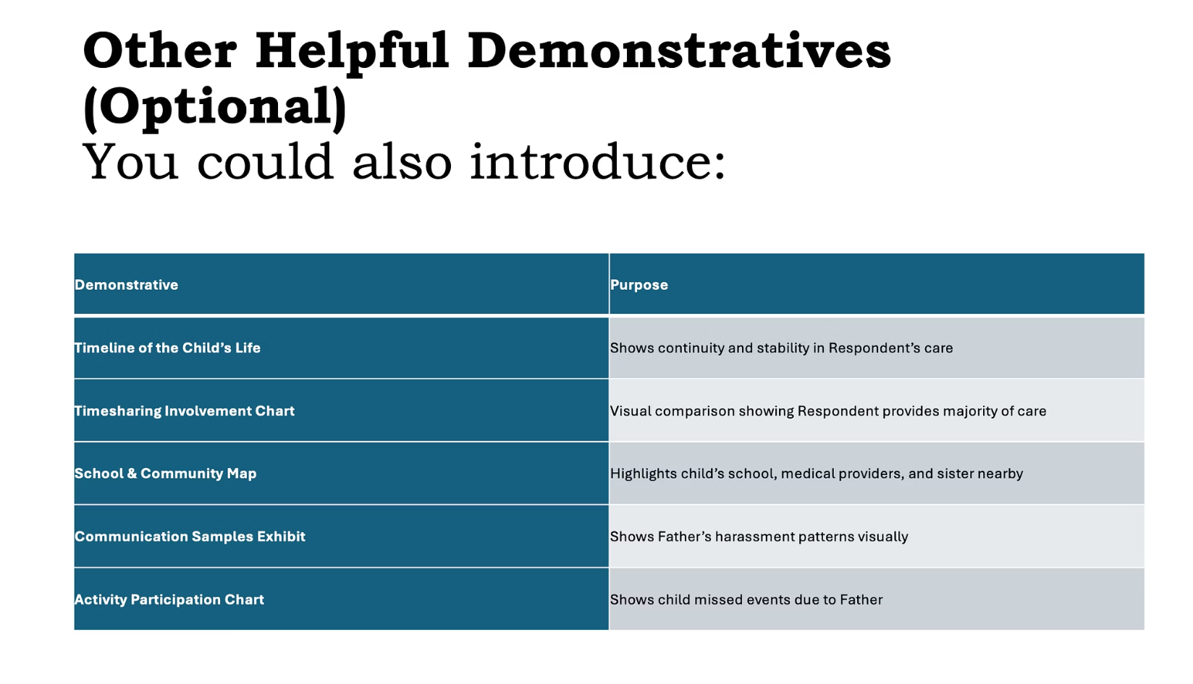
SAMPLE AI GENERATED DEMONSTRATIVE AIDS

