Slide 1
Nuts & Bolts for Florida Family Law Financial Affidavits
November 6, 2025
Marla Chicotsky, Esq. and Lynn M. Britt, CPA, JD
Understanding financial affidavits in family law cases
Notes:
---
This presentation explores the essential role of financial affidavits in Florida family law cases. We will cover their purpose, types, key components, filing procedures, and implications for family law proceedings.

Slide 2

Role of Financial Affidavits in Family Law Cases
Purpose of Financial Affidavits
  Financial affidavits provide detailed financial information of involved parties to aid court decisions on support (child support and alimony) and assets and liabilities (equitable distribution).
  Promoting Fairness & Transparency
  These affidavits ensure transparency and fairness in family law cases by clearly outlining financial status, income, assets, and liabilities.
Notes:
---
These affidavits document the financial status of parties involved, helping courts make informed decisions on support and asset distribution. They promote transparency and fairness in family law proceedings.
Image source: Microsoft 365 content library

Slide 3

Legal Requirements for Disclosure of Financial Information
Mandatory Disclosure (Family Law Rule 12.285)
  Florida law requires complete and truthful disclosure of income, expenses, assets, and debts through a signed affidavit and Certificate of Mandatory Disclosure.
Ensuring Equitable Treatment
  Honest disclosure assures fair treatment and transparency throughout the legal process in financial matters.
Legal Compliance
  Complying with disclosure laws helps avoid legal penalties and maintains integrity in court proceedings.
Notes:
---
Florida law mandates full and honest disclosure of income, assets, debts, and expenses in financial affidavits to ensure equitable treatment and compliance throughout legal processes.
Image source: Microsoft 365 content library

Slide 4
Mandatory Disclosure – Rule 12.285
Florida Family Law Rules of Procedure 12.285 applies to all proceedings within the scope of these rules
Exceptions: cases involving adoption, simplified dissolution, enforcement, contempt, injunctions for protection against domestic, repeat, dating, or sexual violence, or stalking, and uncontested dissolutions when the respondent is served by publication and does not file an answer. Fla. Fam. L. R. P. 12.285(a)(1) (2024).
Additionally, no financial affidavit or other documents shall be required under Rule 12.285 from a party seeking attorney’s fees, suit money, or costs, if the basis for the request is solely under section 57.105, Florida Statutes, or any successor statute. Id.
Except for the provisions as to financial affidavits and child support guidelines worksheets, any portion of Rule 12.285 may be modified by order of the court or agreement of the parties. Id.

Slide 5
Exceptions to the Rules
The parties are not required to file and serve a financial affidavit if they are seeking a simplified dissolution of marriage under rule 12.105, they have no minor children, have no support issues, and have filed a written settlement agreement disposing of all financial issues, or if the court lacks jurisdiction to determine any financial issues. Id. at 12.285(c)(1).
In addition, Rule 12.285(c)(2) allows parties to jointly agree not to file their financial affidavits with the court, and if they do, the court must grant this relief. However, the parties must first agree and evidence their agreement by filing a “notice of joint verified waiver of filing financial affidavits.” Id. The notice must acknowledge: (a) that evidence of their current or past financial circumstances may be necessary for future court proceedings; (b) they each have provided the other with a fully executed and sworn financial affidavit in conformity with Fla. Fam. L. R. P. Forms 12.902(b) or 12.902(c), as applicable; (c) that the responsibility to retain copies of all affidavits exchanged rests solely with the parties; (d) that the waiver only applies to the current filing and does not automatically apply to any future filings; and (e) that the waiver may be revoked by either party at any time. Id.

Slide 6
The Financial Affidavit: Best Practice Tips
Build a checklist for yourself and use it with every affidavit
Clients need to be involved and aware of the contents of the affidavit, but they are not professionals and can’t be expected to prepare an accurate form without assistance.
Notes are a very important part of an affidavit and should appear right below or next to the related item.
Consider using software to assist with the preparation of the affidavit, but don’t trust it without verification.

Slide 7

Consequences of Inaccurate or Incomplete Affidavits
Legal Penalties
  Providing false or incomplete affidavits can result in award of attorney’s fees, sanctions, contempt, and the case matter being vacated.
  Rule 1.540 does not subscribe the one-year time limit to file the Motion to Vacate if there is fraud upon the Court.
  Case Delays
  Inaccurate affidavits may cause delays in court proceedings affecting timely justice. The Court cannot accurately order support or distribute property with false, misleading, or missing financial information.
  Loss of Credibility
  Incomplete or false affidavits undermine trust and damage the credibility of parties involved.
Notes:
---
Submitting false or partial information can lead to legal penalties, case delays, or unfavorable rulings. Accuracy and completeness are essential to maintain credibility and uphold justice.
Image source: Microsoft 365 content library

Slide 8
Fraud on a Financial Affidavit
Fraud on a financial affidavit allows for the case to be opened without any statute of limitations. 12.540(b)
Mason v. Mason, 358 So.3d 1287 (2023)
  Trial court erred by dismissing motion for relief from MSA incorporated into final judgment, which was filed 11 years after entry of final judgment, where former wife asserted that former husband had submitted fraudulent financial affidavits
  Former wife's allegations of fraud were sufficient to invoke rule 12.540(b)
  Court rejected argument that rule did not apply because parties entered into MSA before litigation and discovery

Slide 9

Be Aware of Multiple Deadlines
Included in 12.285
Deadlines to File:
The exchange of mandatory financial documents shall take place within 45 days of the service of the initial pleading, unless otherwise stipulated to by the parties or ordered by court. Fla. Fam. L. R. P. 12.285(b)(2) (2024).
In the event a temporary relief hearing is scheduled within 45 days of service of the initial pleading, then any party requesting temporary relief must produce a financial affidavit, 3 years of income tax returns and 6 months of paystubs to the other party at least (10) days before the hearing. Id. at 12.285(b)(1)(A). The nonmoving party (if not seeking relief) must produce the same set of documents to the requesting party at least 5 days before the temporary relief hearing. Id. at 12.285(b)(1)(B).

Slide 10
Be Aware of Multiple Deadlines Included in 12.285
Deadline to File Motion to Enlarge Time
By agreement of the parties, the time for complying with mandatory disclosure may be extended. Either party also may file, before the due date, a motion to enlarge the time for complying with mandatory disclosure. The court shall grant the request for good cause shown.
Objections to the mandatory automatic disclosure required by this rule shall be served in writing at least 5 days before the due date for the disclosure or the objections shall be deemed waived. Fla. Fam. L. R. P. 12.285(i) (2024). The filing of a timely objection, with a notice of hearing on the objection, automatically stays mandatory disclosure for those matters within the scope of the objection. For good cause shown, the court may extend the time for the filing of an objection or permit the filing of an otherwise untimely objection. The court must impose sanctions for the filing of meritless or frivolous objections.
Deadline to File Objection

Slide 11

Situations Requiring Updated or Amended Affidavits
Financial Status Changes
  Significant changes in financial status necessitate affidavit updates to reflect current information accurately.
Court Orders Impact
  New or modified court orders require affidavits to be amended to comply with legal requirements.
Discovery of New Information
  Uncovered evidence or facts during case discovery prompt necessary updates to affidavits.
Notes:
---
Changes in financial status, court orders, or discovery of new information require parties to update affidavits to maintain accuracy throughout the case.
Image source: Microsoft 365 content library

Slide 12
Duty to Update - Included in 12.285(e)
Whenever a party has a material change in financial circumstances during the action, that party has a duty to supplement documents required under Rule 12.285. Fla. Fam. L. R. P. 12.285(e) (2024).
If an amended financial affidavit or an amendment to a financial affidavit is filed, the amending party must also serve any subsequently discovered or acquired documents supporting the amendments to the financial affidavit.

Slide 13
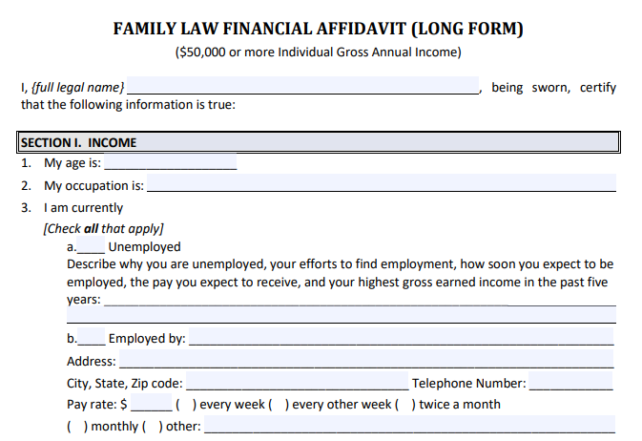
Short Form vs. Long Form Financial Affidavits
Long-Form Affidavits – Form 12.902(c) (Recommended)
  Intended for parties grossing $50,000 or more annually
  It allows for detailed financial information for income, assets, and expenses
  Form recently updated in June 2025
Short-Form Affidavit – Form 12.902(b)
  Intended for parties grossing $50,000 or less annually
  It is less detailed and used for straightforward, lower-income cases
  Form last updated in 2021
Notes:
---
The short form is simpler and used in less complex cases, whereas the long form provides detailed financial information for cases involving significant assets or income sources.
Image source: Microsoft 365 content library

Slide 14

Criteria for Selecting the Appropriate Affidavit
Income Level Consideration
  Income level helps determine the complexity of the affidavit needed for accurate disclosure.
Asset Complexity
  The type and complexity of assets influence the selection of the appropriate affidavit form.
Case Type Impact
  Different case types require specific affidavit forms to ensure relevant information disclosure.
Notes:
---
Factors such as income level, asset complexity, and case type determine which affidavit form is appropriate, ensuring relevant information is properly disclosed.
Image source: Microsoft 365 content library

Slide 15

Tips for Affidavits: Income
$100 per week is not $400 per month
Semi-Monthly and every other week (Bi-weekly) are not the same
Beware of under reported employment income (bonus, overtime, stock grants / options, etc.)
School teacher’s payroll needs to be evaluated for the timing of payments (school year vs. summer)
Social Security Income is often not the amount deposited to the bank (deductions)
Pay stubs may not tell the whole story, but don’t ignore what they do tell you

Slide 16

Tips for Affidavits: Income
W-2 forms should be reviewed carefully. They may include additional income or deductions that impact the affidavit.
Military service members may have additional benefits:
  BAH - Basic allowance for housing (off-base housing)
  BAS - Basic Allowance for subsistence (flat monthly rate for meals)
Additional evaluation if needed for clients paid in cash (unreported income, risk of criminal action)
Don’t forget to include required attachments for the following income items:
  Business income (line 3)
  In-kind income (line 13)
  Rental income (line 11)

Slide 17
Tips for Affidavits: Income

Slide 18
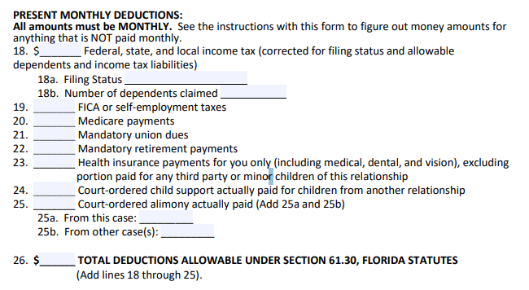
Tips for Affidavits: Taxes & Other Deductions
Income taxes
  Withholding is not equal to actual taxes
  Don’t forget itemized deductions
  Earned income tax credit (EITC)
    Self only
    With child requires physical custody more than half the year
  Dependent care credit
Filing status determination when calculating taxes
  Head of Household status has specific requirements including more than half of overnights
  50/50 custody of more than one child can allow both parents to use Head of Household if time sharing is done properly

Slide 19

Tips for Affidavits: Taxes & Other Deductions
Dependents when calculating taxes
  Self determination (based on time allocated to each parent, or by filing the proper form with the IRS (8332 or 8453 to transmit the 8332 if e-filing) the parent with the lower timesharing can take the deduction
  IRS default with 50 / 50 timesharing and if no agreement is to allow the higher income party to take the deduction
  Not all tax attributes follow the dependent, look them up each time.
FICA (social security) tax applies only to incomes over $176,100 in 2025
Medicare Tax (1.45% on all earnings, 0.09% on earnings over threshold amounts based on filing status)
Designed by Freepik

Slide 20

Tips for Affidavits: Taxes & Other Deductions
There may be health insurance withholding from Social Security
Retirement contributions go in this section only if mandatory
Alimony from “the dark ages” (prior to January 1, 2019) was normally taxable
Union Dues go in this section only if mandatory
Payroll deductions for health, dental, and vison insurance need to be allocated

Slide 21
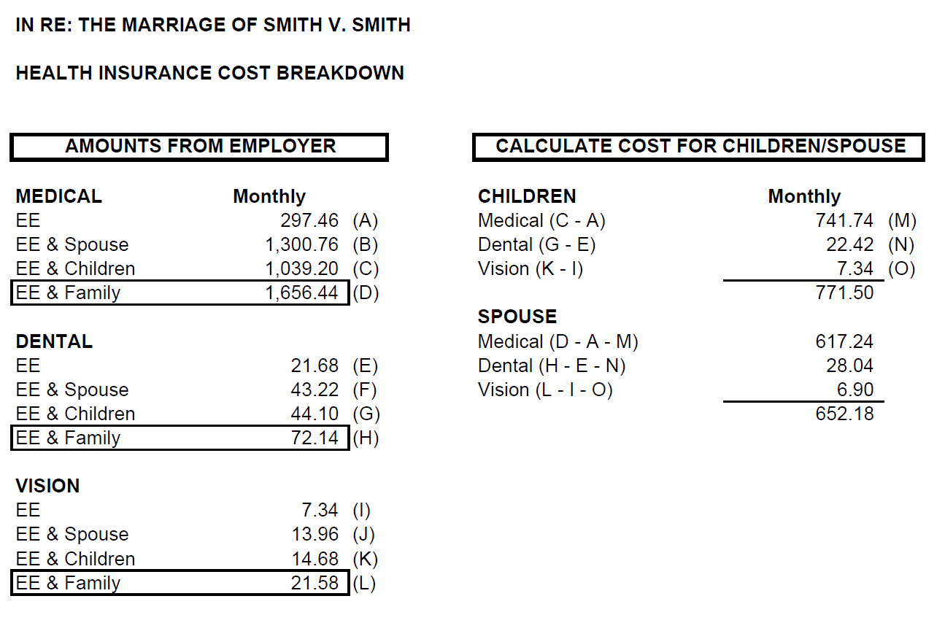
Tips for Affidavits: Taxes & Other Deductions

Slide 22
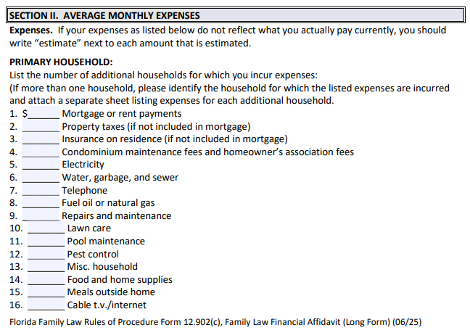
Monthly Expenses on Financial Affidavits
Housing Expenses
  Housing costs form a significant part of monthly expenses, covering rent or mortgage payments and utilities such as electricity, water, and gas bills.
Expenses for Children
  Children’s expenses, school, and other activities are important monthly costs, some of which may be part of the costs to be shared by the parents.
Healthcare Costs
  Healthcare costs include regular medical expenses and insurance, crucial for personal and family well-being.
Notes:
---
Detailing regular expenses such as housing, utilities, education, and healthcare assists courts in understanding financial needs and support calculations.
Image source: Microsoft 365 content library

Slide 23

Monthly Expenses
Expenses may vary between time frames.
If you have a spouse seeking support, consider including three columns for expenses:
  Standard of living during the marriage
  Current expenses
  Post divorce expense
Notes:
---
Detailing regular expenses such as housing, utilities, education, and healthcare assists courts in understanding financial needs and support calculations.
Image source: Microsoft 365 content library

Slide 24
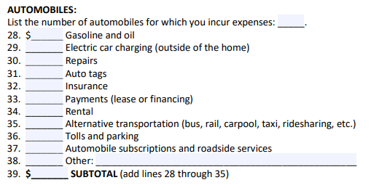

Tips for Affidavits: Expenses
Auto Section on Long-Form Affidavit:
Don’t overlook expenses – use the long form even if income under $50,000.
Separate out expenses for multiple items in one category, such as automobile.
  Show separate amounts for each auto (monthly payment, insurance, repairs, etc.)
Insurance policies contain excellent information to identify assets and the cost of insurance for each asset and/or driver.
Auto Section on Short-Form Affidavit:

Slide 25
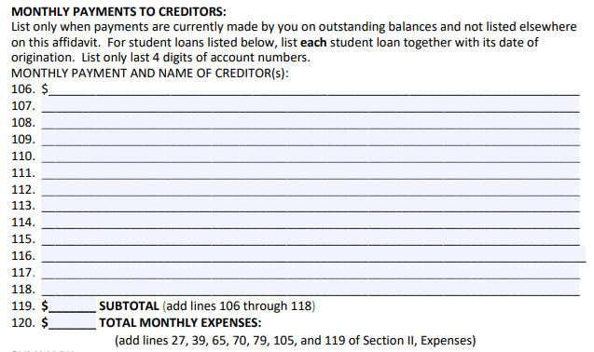
Tips for Affidavits: Expenses
Timeshare maintenance costs are often overlooked
List credit card debts and disclose the source of the payment
  Regular payments
  Minimum payments
  Don’t double dip an expense item paid by credit card with the credit card monthly payment.
Match credit card monthly payments to the credit card debt on the liability section of the affidavit
If there is a deficit - how does the client explain expenses in excess of income?

Slide 26

Assets & Liabilities on Financial Affidavits
Comprehensive asset and liability reporting provides clarity for fair financial distribution.
Assets - Include all properties, bank accounts, and investments to capture total owned resources accurately.
Liabilities - Record debts, mortgages, and loans to present an accurate account of financial obligations.
Notes:
---
This section requires listing property, bank accounts, investments, debts, mortgages, and loans, providing a clear financial snapshot for equitable distribution.
Image source: Microsoft 365 content library

Slide 27
Tips for Affidavits: Assets
List all accounts with specificity (last 4 digits)
Make sure it is clear which assets and liabilities are related (if there are multiple properties with mortgages, note which property each loan relates to)
Life insurance cash value (include term insurance)
Personal property is often incorrectly valued
  Your client does NOT know what their “stuff” is worth
  Interview them
  Consider valuations for significant items

Slide 28
Tips for Affidavits: Assets
Business interest and valuation of businesses
  Clients don’t know what their business is worth
  Divorce valuation may differ from valuation for sale
  If business owns real estate, consider listing on affidavit with any debts
  Beware of clients using business bank accounts or credit cards for personal expenses (may be in-kind depending on how accounted for in the books and records)

Slide 29
Tips for Affidavits: Assets
Other assets commonly missed:
  HSA accounts
  Children’s accounts (529 or FL prepaid plans)
  Capital loss or net operating loss carry forwards
  Tax refunds pending or applied
  Patents / copyrights / trademarks
  Use rights (property, air, water, land)
  Licenses / Royalty Agreements
  Prepaid funeral or cemetery plots
  Accrued vacation or PTO
  Reward points, mileage points, hotel credits (if significant)
  Timeshare asset value and purchase balances due
  Foreign assets
  Treasury bonds

Slide 30
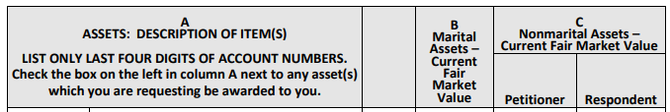

Tips for Affidavits: Assets
Assets should be evaluated for marital / non marital components (investments, retirement accounts, drop accounts, etc.)
Misclassification of assets with marital and nonmarital components
  How to report a mixed-character asset?
  Issue with the new form

Slide 31
Tips for Affidavits: Liabilities
There may be loans on employer retirement plans, statements can be confusing
Credit report can provide valuable information, but if obtained will need to be provided in Mandatory Disclosure
Auto leases are not liabilities (or assets), they are an expense
  An exception might be for a refundable deposit or projected balance due based on damage or mileage over contracted amount
Balances due for attorney, forensic accountant, other professionals should be individually listed
Liabilities also need to be evaluated for marital / nonmarital status

Slide 32

Frequently Encountered Errors and Omissions
Missing Information
  Omitting essential information can lead to misunderstandings and negatively impact case outcomes.
Calculation Errors
  Errors in calculations can cause incorrect results and jeopardize the accuracy of case data.
Failure to Update
  Not updating information timely can result in outdated data affecting decisions and outcomes.
Incomplete Documentation
  Incomplete records hinder clarity and may compromise the overall integrity of the case.
  Irrelevant Information
  Do not include irrelevant opinions in the affidavit. Your client will have the opportunity to give their opinions at a later point in time.
Notes:
---
Common issues include missing information, calculation errors, failure to update, and incomplete documentation, which can jeopardize case outcomes.
Image source: Microsoft 365 content library

Slide 33

Best Practices for Ensuring Accuracy and Compliance
Double-Checking Data
  Reviewing data thoroughly minimizes errors and increases document accuracy for legal processes.
Legal & Financial Consultation
  Consulting legal and financial professionals ensures compliance with standards and proper affidavit preparation.
Organized Record Keeping
  Maintaining well-organized records simplifies updates and ensures traceability of affidavits.
Notes:
---
Double-checking data, consulting legal professionals, maintaining organized records, and promptly updating affidavits help ensure reliability and court acceptance.
Image source: Microsoft 365 content library

Slide 34

Use of Affidavits in Child Support Calculations
Purpose of Affidavits
  Affidavits provide detailed financial information crucial for calculating child support fairly.
Role of Courts
  Courts use affidavits to assess parental financial capacity and child needs.
Notes:
---
Courts rely on accurate affidavits to determine fair child support amounts based on each parent's financial capacity and needs of the child.
Image source: Microsoft 365 content library

Slide 35

Influence on All Aspects of Your Case
Role of Financial Disclosures
  Financial disclosures provide critical information for determining fair spousal support and asset division in divorce cases.
Ensuring Equitable Outcomes
  Transparency in financial information helps courts achieve fair and balanced decisions for both parties involved.
Role in Negotiations
  Affidavits support negotiation and settlement discussions by providing verified statements.
Evidence in Trials
  Affidavits serve as critical evidence during court trials, aiding the Court to order proper support and equitable distribution of the marital estate.
Notes:
---
Financial disclosures guide decisions on spousal support and division of marital assets, ensuring equitable outcomes for both parties.
Image source: Microsoft 365 content library

Slide 36
IRS RESOURCES
Don’t underestimate the IRS. They have publications on most any topic you would need to investigate for your divorce client.
  https://www.irs.gov/taxtopics Tax topics with a search function
  https://www.irs.gov/forms-pubs/about-publication-504 Divorced or Separated Individuals
  https://www.irs.gov/forms-pubs/about-publication-501 Dependents, Standard Deduction, and Filing information.
  https://www.irs.gov/taxtopics/tc751 Social Security and Medicare withholding rates
  https://www.irs.gov/pub/irs-pdf/p596.pdf Earned Income Credit
  https://www.irs.gov/tax-professionals/eitc-central/divorced-and-separated-parents
  https://www.irs.gov/pub/irs-pdf/p5802.pdf Divorce & Taxes Checklist

Slide 37
Contact Information
Marla Chicotsky, Esq.
Chicotsky Law, P.A.
(954) 271-3310
marla@chicotskylaw.com
www.chicotskylaw.com
Lynn M. Britt, CPA, JD
Britt & Company, P.A.
(954) 718-5022
lynn@cpabritt.com
www.cpabritt.com

